Slide 1
Use Cases
http://www.es.net/science-engagement/science-requirements-reviews/
Energy Sciences Network (ESnet)
Lawrence Berkeley National Laboratory
Jason Zurawski – zurawski@es.net
Kate Petersen – kate@es.net
RMACC Symposium and RMCMOA Workshop
August 11th 2016
© 2016, The Regents of the University of California, through Lawrence Berkeley National Laboratory (subject to receipt of any required approvals from the U.S. Dept. of Energy). All rights reserved.
NOTICE. This material is owned by the U.S. Department of Energy. As such, the U.S. Government has been granted for itself and others acting on its behalf a paid-up, nonexclusive, irrevocable, worldwide license in the material to reproduce, prepare derivative works, and perform publicly and display publicly.

Slide 2
Outline
Introduction
Examples
ALS Workflow
APS Science DMZ
Conclusions

Slide 3
Introduction
Engagement with end users normally starts with a scripted set of things to address
All items from case study template
Info on traffic flow (if you have it)
A previous complaint or request (if one was made)
The individual fixes from an engineering perspective can diverge into categories
Host tuning/upgrades
Introduction of new software
Network tuning/upgrades
Sociological factors (new approaches to known problems)
Here are a couple of quick examples and outcomes

Slide 4
Outline
Introduction
Examples
ALS Workflow
APS Science DMZ
Conclusions

Slide 5
Advanced Light Source

Slide 6
Advanced Light Source

Slide 7
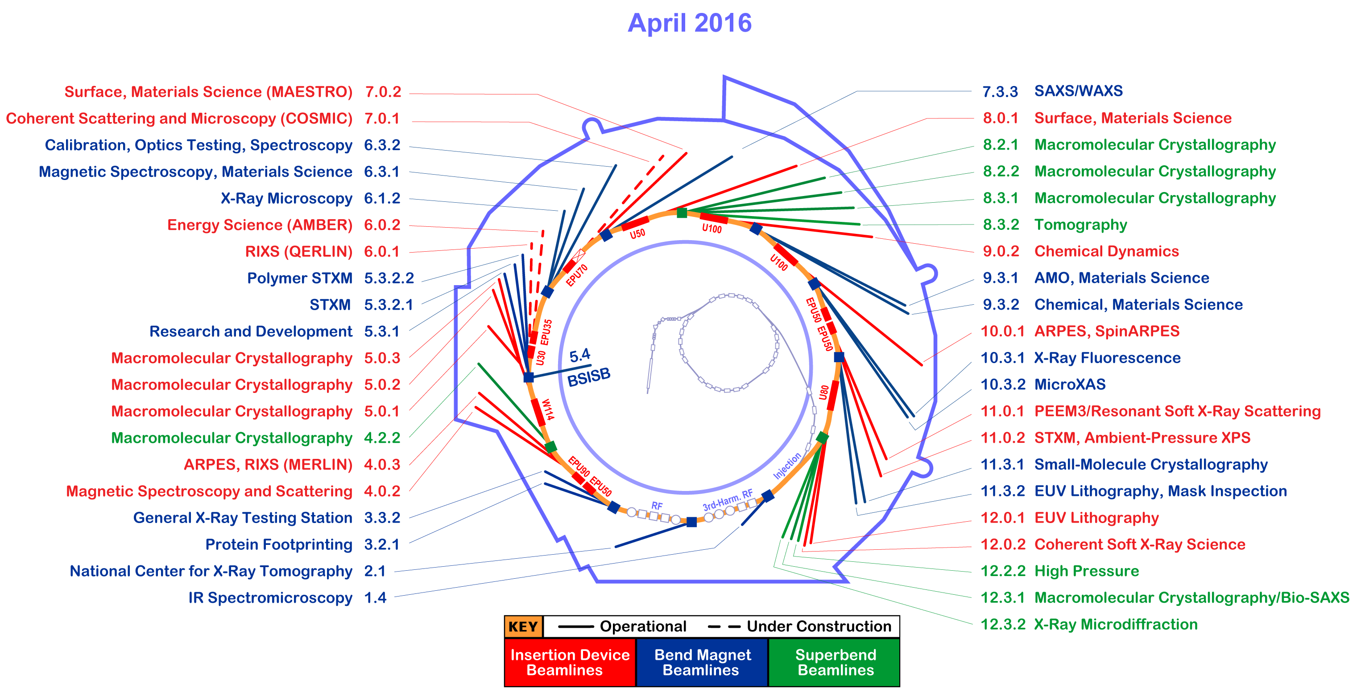
Big Science Now Comes in Small Package
Notes:
Beamline 8.3.2 at the Advanced Light Source is a Synchrotron-based Hard X-ray Micro-Tomography instrument. It allows non-destructive 3-Dimensional imaging of solid objects at a resolution of approximately 1 micron.
10⁶ increase in data output compared to previous generation
8 Gbps flows to supercomputer for real-time analysis

Slide 8
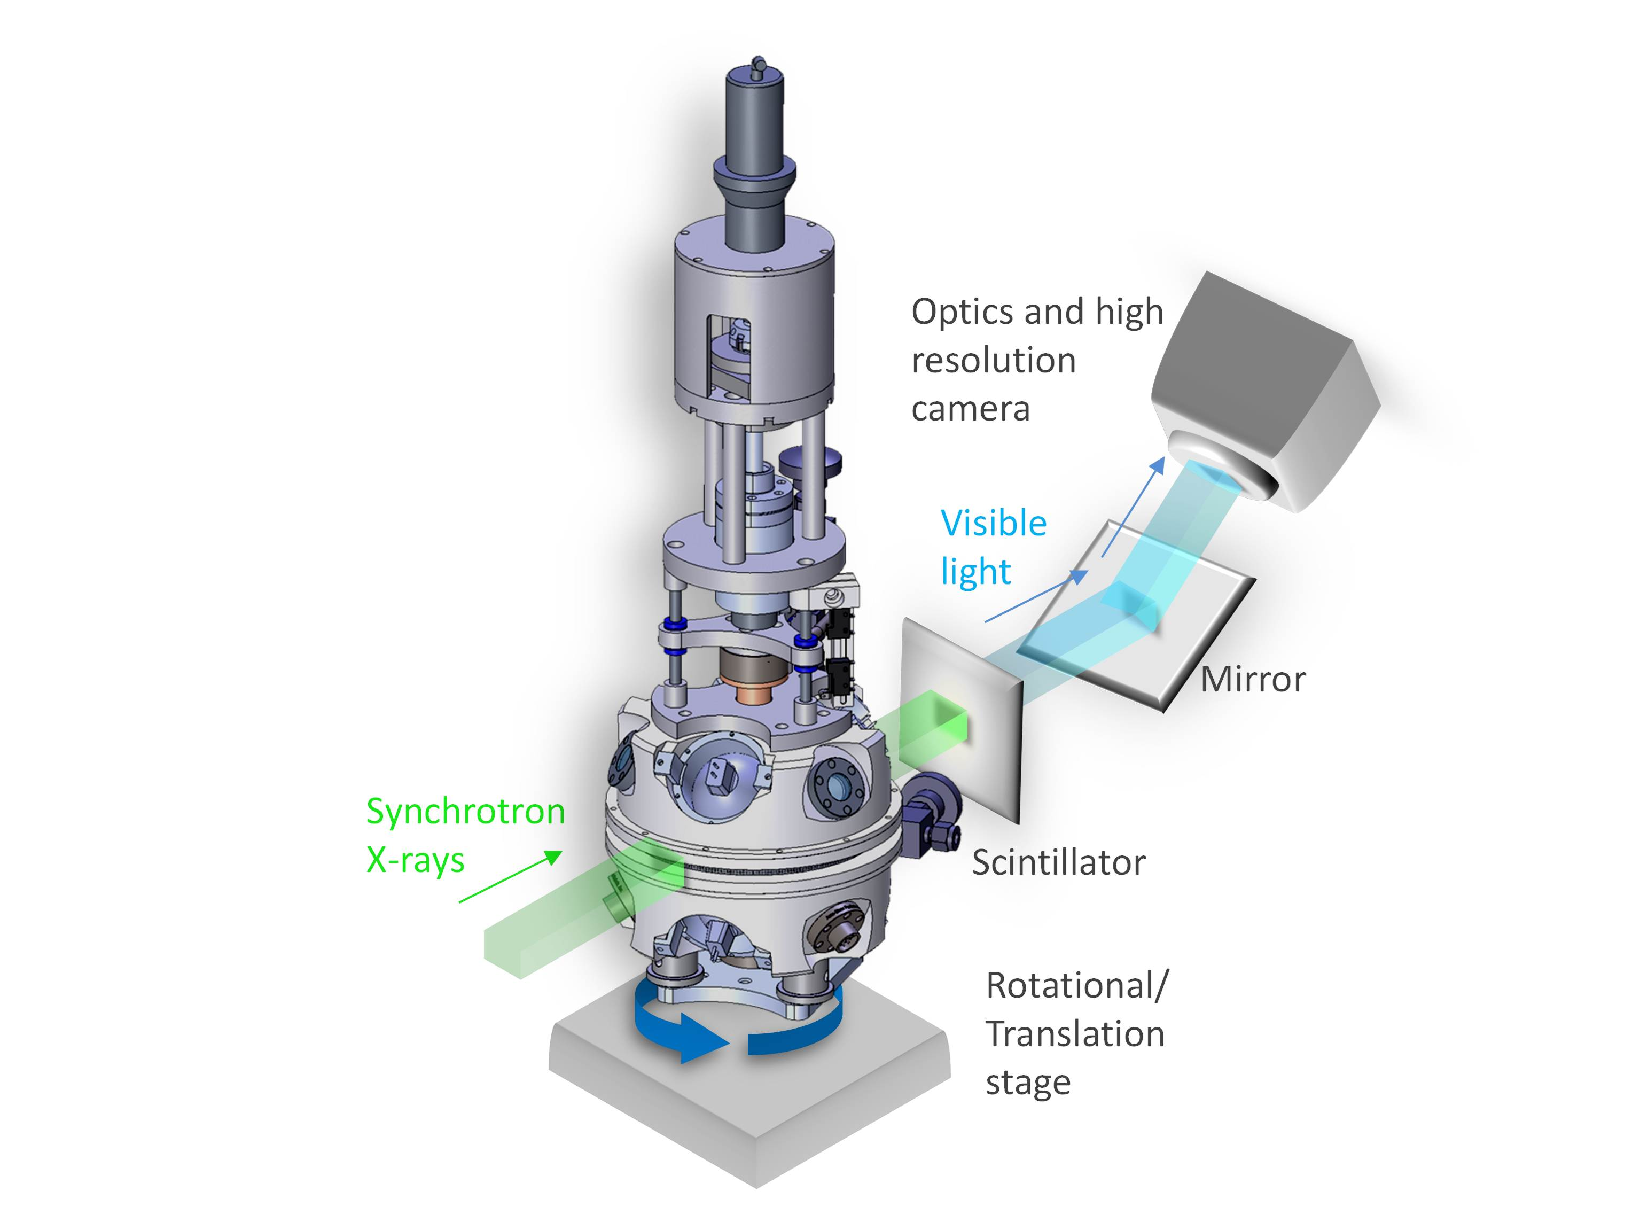
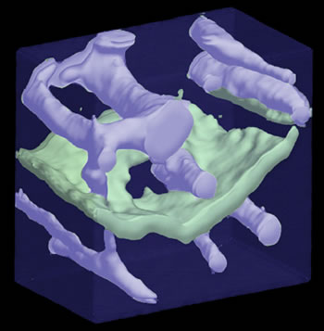
Application – Capture to Results
Basic Energy Sciences (BES) supports fundamental research to understand, predict, and ultimately control matter and energy at the electronic, atomic, and molecular levels in order to provide the foundations for new energy technologies and to support DOE missions in energy, environment, and national security.
http://science.energy.gov/bes/

Slide 9
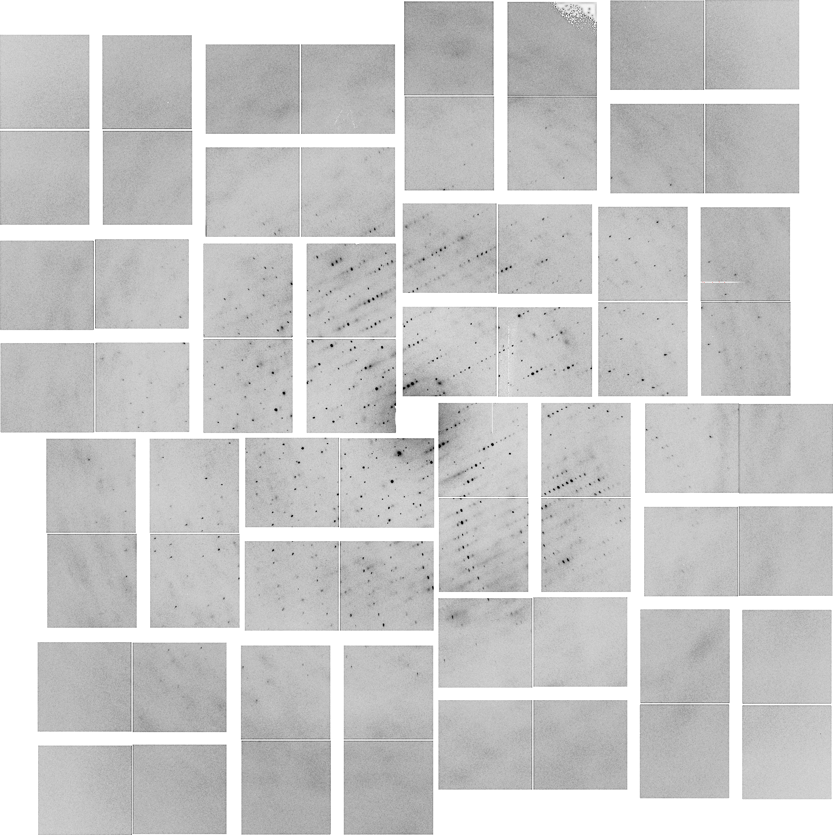
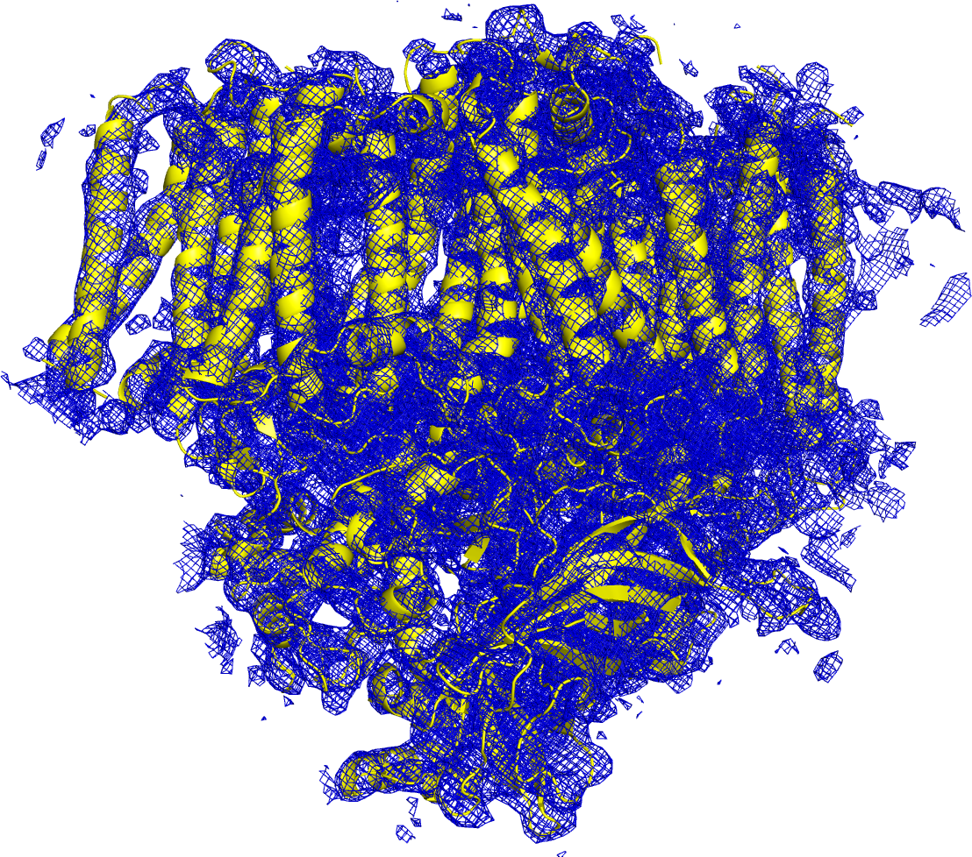
E Pluribus Unum
Processing on this order of magnitude can’t be done locally – we need to send (over a network) to a more capable facility
Hundreds to thousands of images are created in a few hours…they can range in size from MB to TB
After processing on a supercomputer, models are created.
9 – ESnet Science Engagement (engage@es.net) - 9/15/16

Slide 10
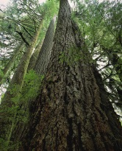
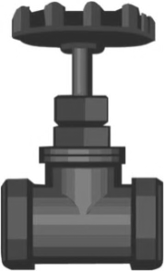
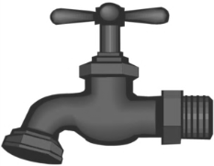
User Workflow: Beamline 8.3.2
2. Endstation
3. Sample
4. Control Software
5. Data Collection
Users
1. Allocation
6. Data Transfer / Management
Publications
9. Write and edit
8. Data Analysis / Info Extraction / Visualization / Simulation
7. Data Processing

Slide 11
Science Workflow Consultation
Notes:
X-ray tomography beamline
General purpose network
Windows shares on an old computer with not enough storage
Data acquisition uses LabView
Data written to shared drive on firewalled Windows server
Analysis done on workstations
High-powered Windows hosts
Mix of proprietary and open-source tools
Scientists can be physically present or use Remote Desktop
Data export post-analysis – physical transport of portable media
USB hard drives

Slide 12
Improved Workflow Infrastructure
Notes:
Dedicated infrastructure, built for performance, outside the general purpose network, clear path to NERSC
Data acquisition uses LabView
Data written to SAMBA share on beamline Linux DTN
Writing via SAMBA is faster than local disk on acquisition computer
Data are TIFF files ~10MB each, ~1000 files per data set
Current max performance is ~200MB/sec
Automated workflow pushes data to NERSC for analysis
Workflow managed using signal files
Data set is rolled up into an HDF5 file
Python scripts drive Globus Online CLI
Data transferred to NERSC DTNs at ~300MB/sec
Analysis results pulled back to beamline DTN
Additional analysis done on workstations (still use some proprietary tools)
Primary data export is via Globus Online from beamline DTN

Slide 13
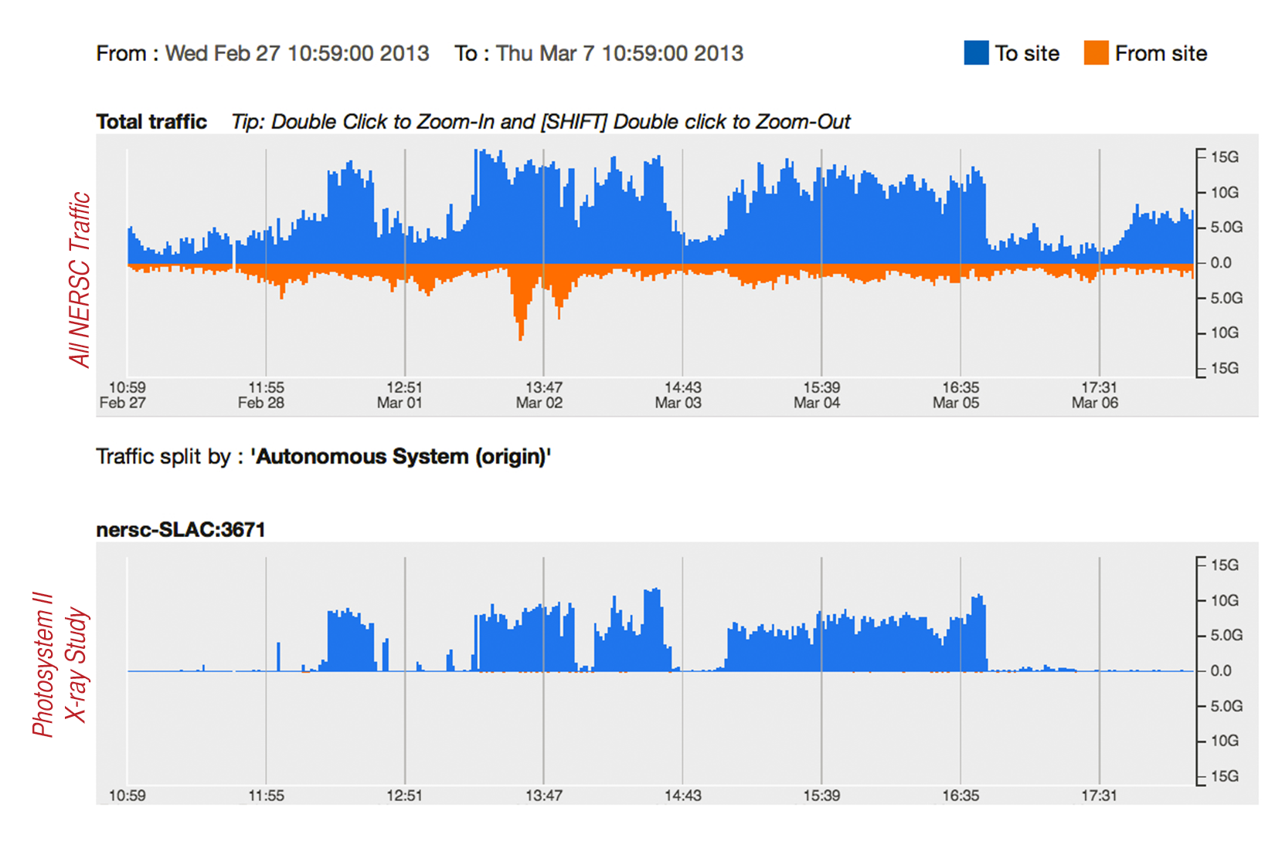
One Beamline Data Flow Tripled Network Use for a DOE Supercomputing Center

Slide 14
Outline
Introduction
Examples
ALS Workflow
APS Science DMZ
Conclusions

Slide 15
APS Science DMZ
Building on the success of ALS, we approached the APS (Advanced Photon Source) at Argonne National Laboratory about a similar effort.
Goal(s):
Establish a Science DMZ Network for a small number of beamlines
Measurement before/after network performance
Upgrade data movement hardware
Measurement before/after data movement performance
Onboard users to the system, and upgrade home institutions (as needed)

Slide 16
GM/CA
General Medical Sciences and Cancer Institutes Structural Biology Facility @ APS
Focused on the study of crystallographic structure determination of biological macromolecules by X-ray diffraction
Typical User:
Visits and spends some allocated time with samples and the beamline machinery
Mails samples, controls device remotely
In either case – data has to go ‘somewhere’

Slide 17
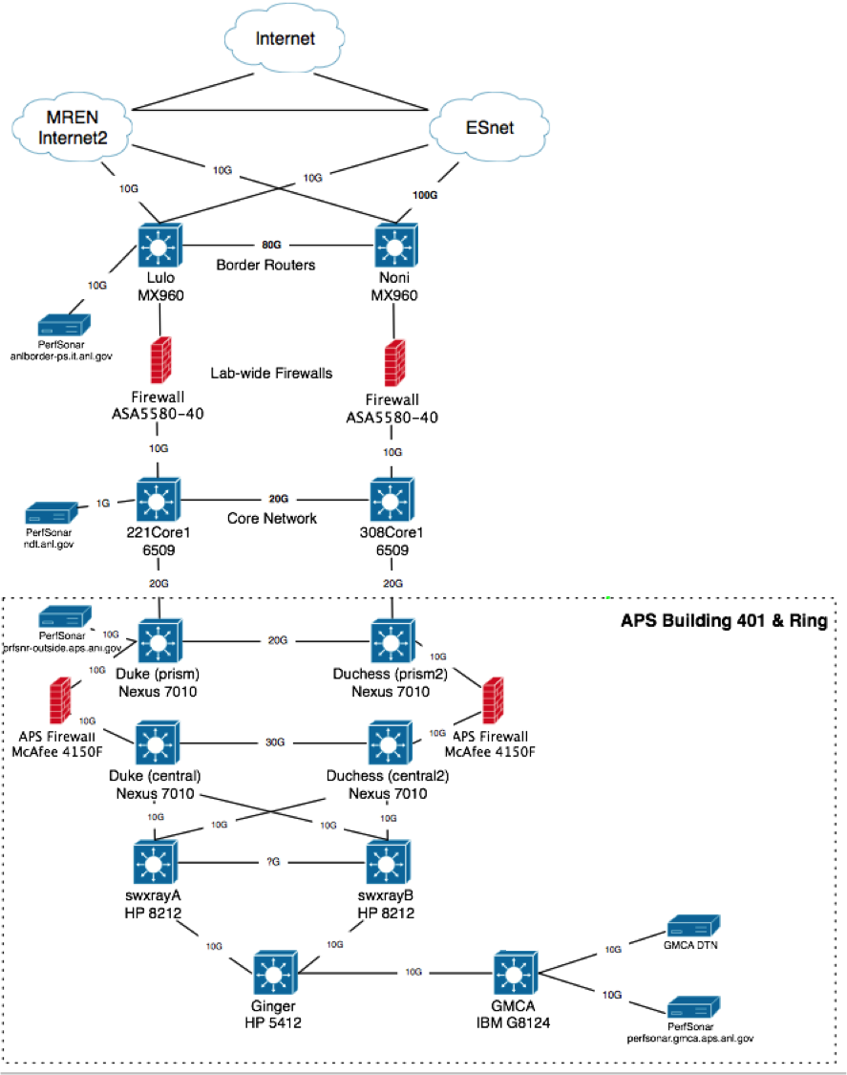
Current Design

Slide 18
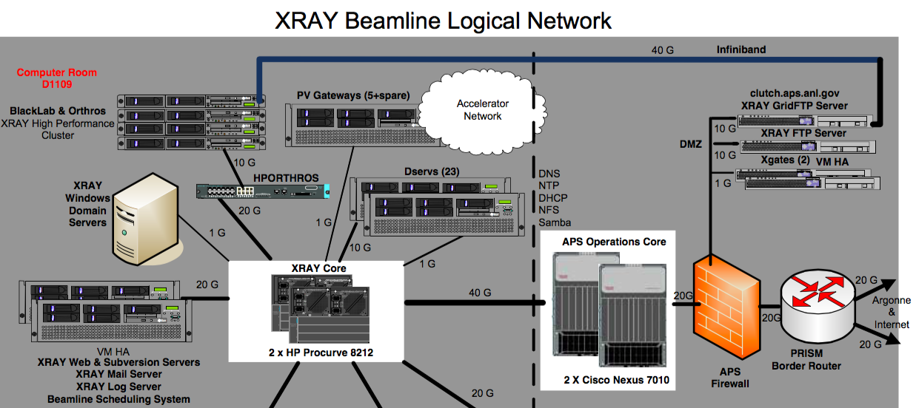
Current Design

Slide 19
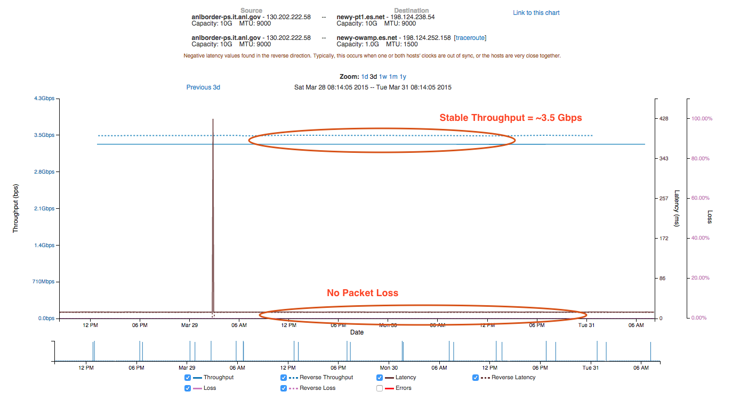
ANL Border to ESnet New York (perfSONAR Test)

Slide 20
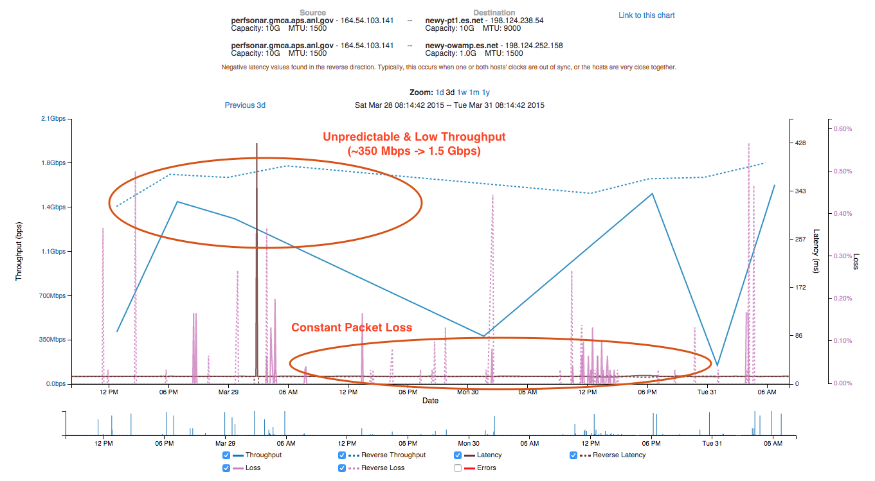
GM/CA to ESnet New York (perfSONAR Test)

Slide 21
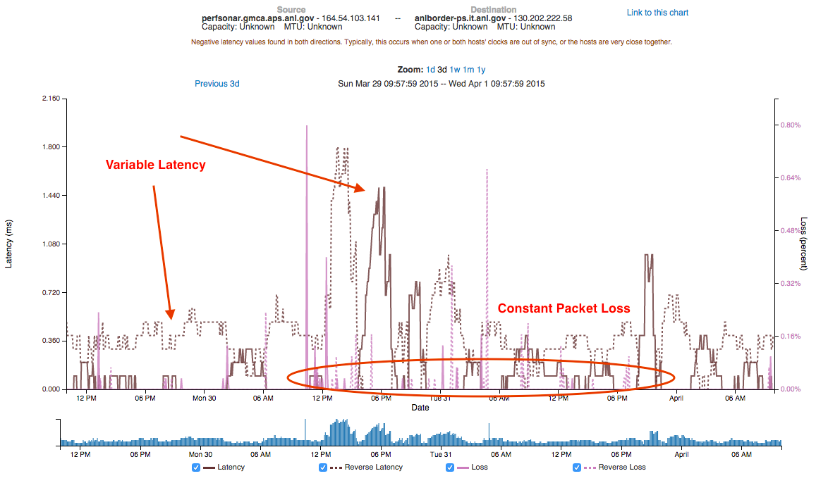
GM/CA to ANL Border (perfSONAR Test)

Slide 22
A small amount of packet loss makes a huge difference in TCP performance
Local
(LAN)
With loss, high performance beyond metro distances is essentially impossible
International
Metro Area
Regional
Continental
Measured (TCP Reno)
Measured (HTCP)
Theoretical (TCP Reno)
Measured (no loss)
Notes:
This is an annotated version of the plot from the Science DMZ paper
Beyond your metro area, zero loss is essentially required for high performance
Where are your collaborators? Where are your users?
When global collaboration is the norm, nobody can afford to be a local-only resource

Slide 23
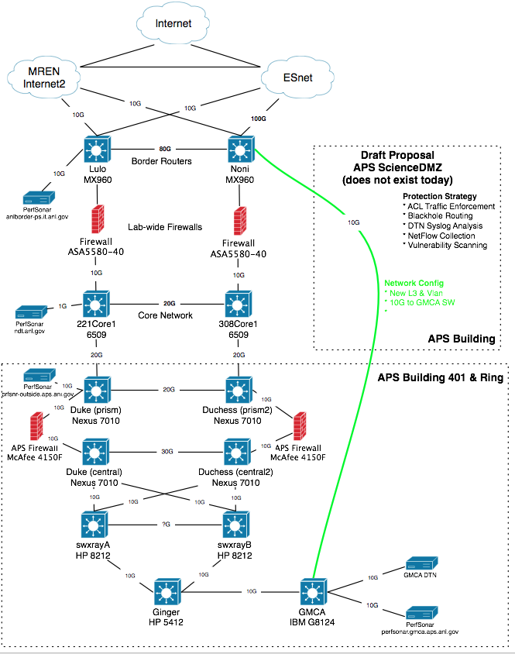
Pilot Network
Plan:
Use campus and building fiber resources for 2nd path
Applies to only a limited set of resources (perfSONAR, DTN)
Benefits
Bypass congested local infrastructure
Apply targeted (vs. blanket) security policy
Cautions:
Prevent just ‘anything’ from using fast path – policy to control this
Still need to figure out cause of local issues (e.g. this isn’t a pave over)

Slide 24
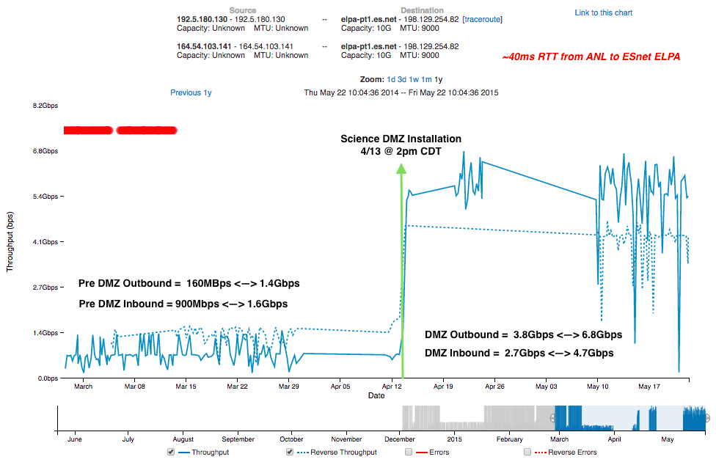
perfSONAR Results

Slide 25
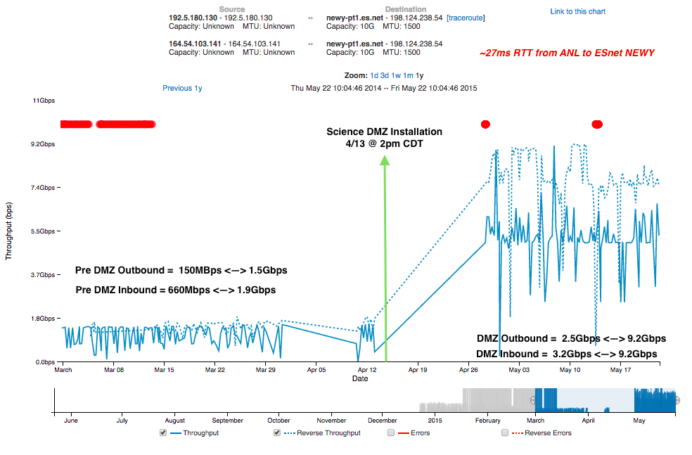
perfSONAR Results

Slide 26
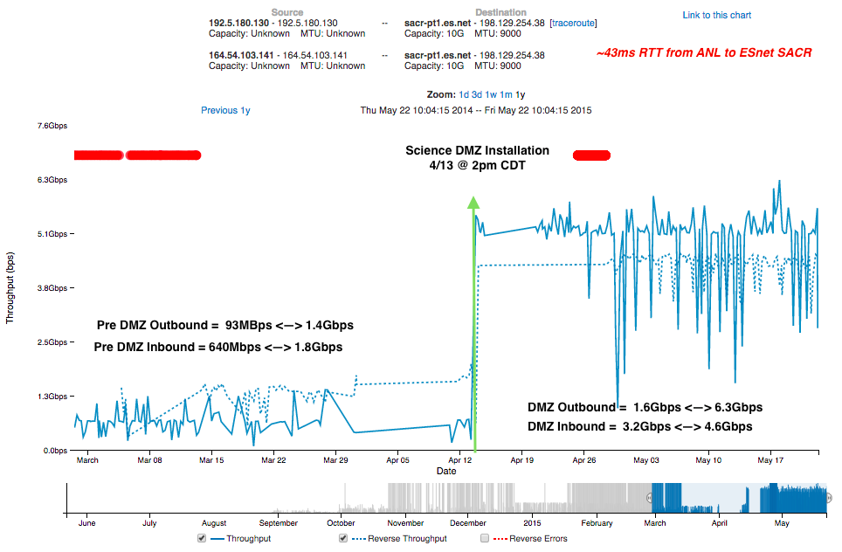
perfSONAR Results

Slide 27
perfSONAR – what about GridFTP?
Setup of the DTN Architecture:
2 Servers
Shared filesystem
Each server has 2 interfaces/routes:
Science DMZ routes (plumbed to specific external locations via ANL, ESnet/MREN) and avoiding slower path
Traditional routes over slower path
Goal: show that with the correct network the *SAME* underlying infrastructure can perform as well as the perfSONAR testing

Slide 28
Testing ESnet CERN (long RTT) to GMCA
Scale is Mbps
Across the board improvement of around 5x-20x
Exercise helped to tune filesystem performance.

Slide 29
Testing GMCA to ESnet CERN (long RTT)
Metadata operations (e.g. deeply nested directories) coupled with smaller files remains hard to crank up

Slide 30
Testing GMCA to ESnet LBL (medium RTT)
Metadata operations (e.g. deeply nested directories) coupled with smaller files remains hard to crank up

Slide 31
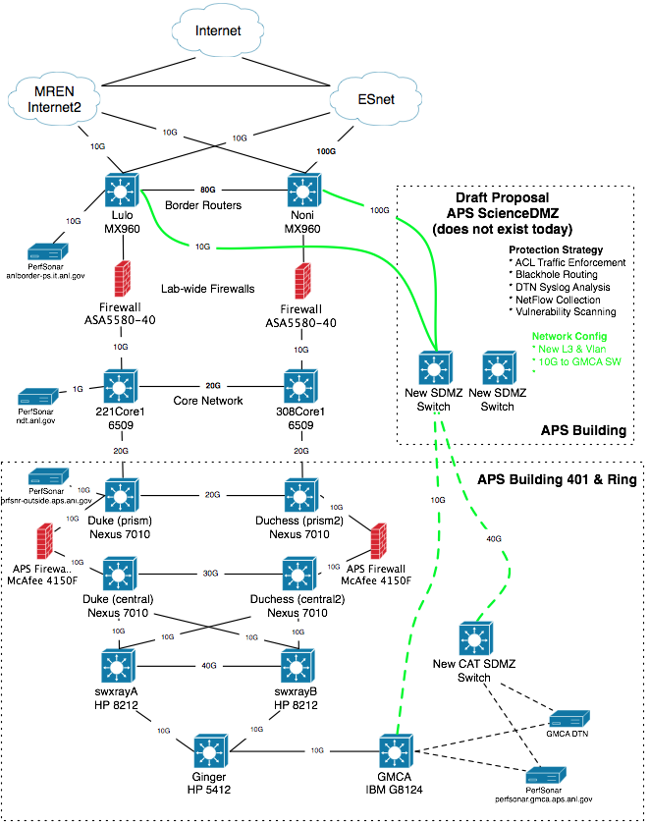
Future
Wider use @ APS
Solution now goes directly to a specific beamline – how to support the entire facility?
Wider use @ ANL
Service for other research groups (e.g. ALCF, ARM, etc.)
Pool of DTN resources w/ Globus, instead of each group manning their own (allows to back up to communal storage)
Defining Policy
ACLs – ports exposed for things like perfSONAR, Globus. Shut off for things that don’t need it. Gray area is defining what is and is not science.
Who gets on, who doesn’t
Managing routing @ the border to best utilize the available WAN links

Slide 32
Outline
Introduction
Examples
ALS Workflow
APS Science DMZ
Conclusions

Slide 33
Conclusion
Many scientific disciplines are moving toward a model that automates the process
Upgraded networks
Access to computation (somewhere)
Advanced software
Adopting these superfacility workflows earlier will help convince those that do not have a good handle on technology to move in that direction
This simplifies the IT job – less special snowflakes

Slide 34
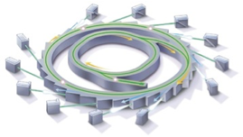
Superfacility elements multiply with growing interconnectedness. 2025 DOE Light sources:
Integration of experimental and computational facilities in real time, using programmable networks.
Detectors capable of generating terabit data streams.
Computational tools for analysis, data reduction, feature extraction in situ, using advanced algorithms and specialized hardware.
Data management and sharing, with federated identity management and flexible access control.
Increased scientific throughput from robotics and automation software.
Post-processing: reconstruction, inter-comparison, simulation, visualization.

Slide 35
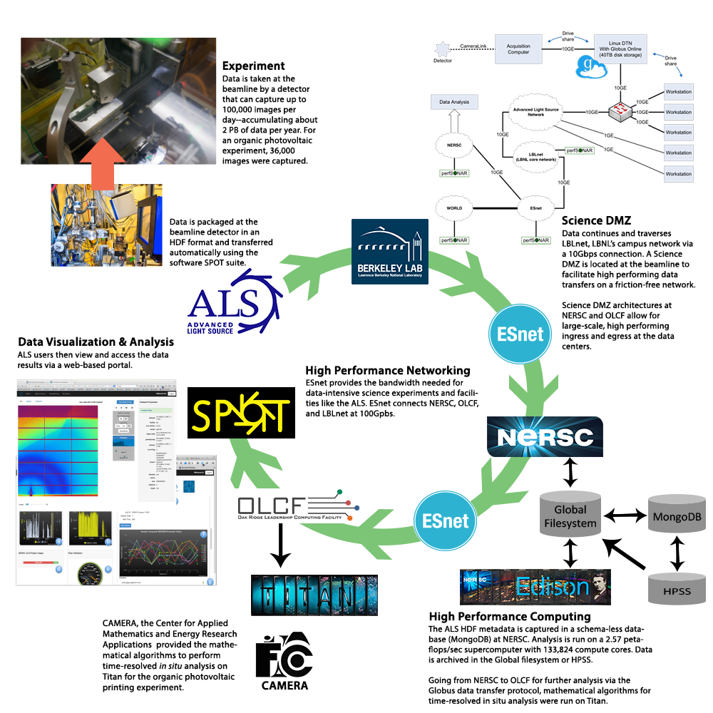
Lightsource
Superfacility
Prototype
2015

Slide 36
Use Cases
http://www.es.net/science-engagement/science-requirements-reviews/
Energy Sciences Network (ESnet)
Lawrence Berkeley National Laboratory
Jason Zurawski – zurawski@es.net
Kate Petersen – kate@es.net
RMACC Symposium and RMCMOA Workshop
August 11th 2016
© 2016, The Regents of the University of California, through Lawrence Berkeley National Laboratory (subject to receipt of any required approvals from the U.S. Dept. of Energy). All rights reserved.
NOTICE. This material is owned by the U.S. Department of Energy. As such, the U.S. Government has been granted for itself and others acting on its behalf a paid-up, nonexclusive, irrevocable, worldwide license in the material to reproduce, prepare derivative works, and perform publicly and display publicly.

Slide 37
Extra Slides

