Slide 1
Gathering Requirements Using Technology
http://www.es.net/science-engagement/science-requirements-reviews/
Energy Sciences Network (ESnet)
Lawrence Berkeley National Laboratory
Jason Zurawski – zurawski@es.net
Kate Petersen – kate@es.net
RMACC Symposium and RMCMOA Workshop
August 11th 2016
© 2016, The Regents of the University of California, through Lawrence Berkeley National Laboratory (subject to receipt of any required approvals from the U.S. Dept. of Energy). All rights reserved.
NOTICE. This material is owned by the U.S. Department of Energy. As such, the U.S. Government has been granted for itself and others acting on its behalf a paid-up, nonexclusive, irrevocable, worldwide license in the material to reproduce, prepare derivative works, and perform publicly and display publicly.

Slide 2
Outline
The Role of Technology
Defining Use Cases
Sensible Campus and Regional Policies

Slide 3
The Role of Technology
Technology has an important role in the science review process:
Delivers metrics on data type, size, duration, and locality
Offers important time-based comparisons
Can serve as both an early warning system, as well as a continuous gauge for certain classes of users
There are some things technology can’t do:
Predict growth and traffic patterns for future science in a vacuum
Succinctly identify areas of friction within the workflow
Serve as the only justification for upgrades

Slide 4
The Role of Technology - Pros
Technology Metrics
Passive Monitoring: gathered from devices in the network either in a pull or push fashion
Network Device “Counters” (SNMP, TL1)
Flow Data (Netflow, sFlow, jFlow)
Logging on key resources (syslog/splunk on a DTN running Globus)
Active Monitoring: requires deployment of dedicated monitoring resources that test on a schedule (e.g. perfSONAR and similar tools)
Data Behavior (Latency, Loss, Duplication, Jitter)
Throughput/Bandwidth
Routed Path

Slide 5
Passive Monitoring
Most network devices support these
Typically gathered centrally (requires trust if you want to see parts of the network you don’t directly administer)
Can be configured to poll on different intervals
Slow = less resource intense but incapable of seeing detailed behavior
Fast = more resource intense and representative of typical use
SNMP/TL1: Raw counters that explain a behavior (data passing through an interface, number of errors observed)
Flow: detailed records of traffic patterns (origin, protocol). Due to the nature of the data, privacy can sometimes be a concern
Logging: aggregating log values for performance or other events in a central location to aide in analytics.

Slide 6
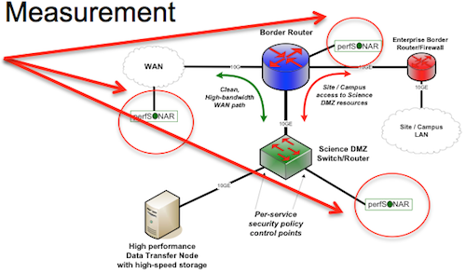
Active Monitoring
Serves a dual purpose:
Useful for establishing a baseline of network performance over time
Can be used as a ‘canary’ to detect problems and aid in debugging
Requires investment into server class hardware, and deployment at key network junctions:
Border
Core
High traffic areas (HPC center)
Does not offer details about the ‘why’ of network traffic, but can tell you ‘how’ and ‘when’ which are useful for determining patterns and areas of friction

Slide 7
The Role of Technology - Pros
For both types – it is useful to determine trends over time
Establishing patterns based on day of week, time of year
Correlating this against network maintenance, upgrades, and other events of interest (e.g. security events, software updates)
Additional insight into the locations of data flow:
Border monitoring is useful, but not as useful as instrumentation in front of a key research building or facility
Additional telemetry (if possible) down to the machine level, e.g. knowing which DTNs are being used and when

Slide 8
The Role of Technology - Pros
Identifying User Behavior is possible as the level of instrumentation increases:
Flow data in a single location (e.g. the border) can only tell you what is coming/going, and not where it goes within the campus
Instrumentation to the building level can help find where users are sitting
Instrumentation to the floor/room level can identify the machines and protocols being used
Once you identify users (perhaps those you were unaware of), it is easier to begin a conversation about what they are doing and how well it is working

Slide 9
User Engagement Examples
Medium to Large flows coming from a specific building
New DTN and data movement tool. Check in to see if its working as expected
Many small (but long lived) flows of SSH from a specific research group
User may be unaware of advanced tools and is relying on SCP/RSYNC for data movement. Engage on alternative methods.
Intense activity during off-peak hours
Congestion probable during the day; easier to move data off-peak. Consider capacity augmentation or traffic management.
Lots of flows with an origin AS of a specific regional/campus network
New collaboration between a local user and a remote instrument

Slide 10
The Role of Technology - Cons
Pattern recognition is possible, but not fully automated
Unless every device is fully instrumented, its impossible to know what is specifically happening
Large flows could be science, they could also be P2P traffic
More instrumentation the better – but also more discussion the better.
Use observations on traffic increases/known protocols/specific locations as a starting point
Informal conversations about what is going on can lead to a large discussion later on support/upgrades

Slide 11
The Role of Technology - Cons
Finding friction can still be a random walk
perfSONAR is useful for establishing a gauge of performance over time
Relies heavily on the vantage point
On the border it tells you what the path is from the border to remote locations
From the HPC center it tells you the path from there to other remote locations
If these two are different, it could point out localized friction in the campus. If they are the same, it could point to friction outside of your control
As in the previous – ‘more is better’ for visibility
Establish multiple testers and configure useful tests
Non-useful tests:
Intense ‘LAN’ bandwidth testing (remember TCP dynamics)
Tests known to ‘pass’ (we want this to alarm/alert, not be green)
Taking a path the user doesn’t take (e.g. if they are behind a firewall, test from there)

Slide 12
The Role of Technology - Cons
Justification needs multiple voices
Upgrading when you hit a utilization mark (e.g. 60%) makes sense from an institutional perspective.
Upgrading when there is a clear scientific need helps convince funding bodies
Both approaches are necessary, neither can stand alone

Slide 13
Outline
The Role of Technology
Defining Use Cases
Sensible Campus and Regional Policies

Slide 14
Defining Use Cases
Passive Monitoring
Layer 2 (TL1) Approaches
Layer 3 (SNMP) Approaches
Flow
Logging
Active Monitoring via perfSONAR Deployment

Slide 15
Passive – TL1
N.B. This applies only to sites that are running their own Layer 2 Local/Metro/Wide Area infrastructure
TL1 typically gives a number of important metrics:
Light/Power Levels
Alarms
Counters (Utilization, errors, etc.)
It’s useful to know when ‘hot spots’ appear via the counters
In terms of a general monitoring strategy, the other items can help alert when things fail below the network layer
Suggested Deployment: Central collector getting this data from all capable devices

Slide 16
Passive – SNMP
SNMP typically gives a number of important counter metrics.
It also delivers oodles more (depending on machine MIB) that may not be as useful
It’s useful to know when ‘hot spots’ appear via the counters
It’s less useful to walk and retrieve the entire device MIB. Pick the items that matter, and poll them as fast as the machine will allow (10 to 30 seconds if possible)
Get this from every device you control (and some that may belong to your science friends – if they will let you)
Suggested Deployment: Central collector getting a subset of data from all capable devices

Slide 17
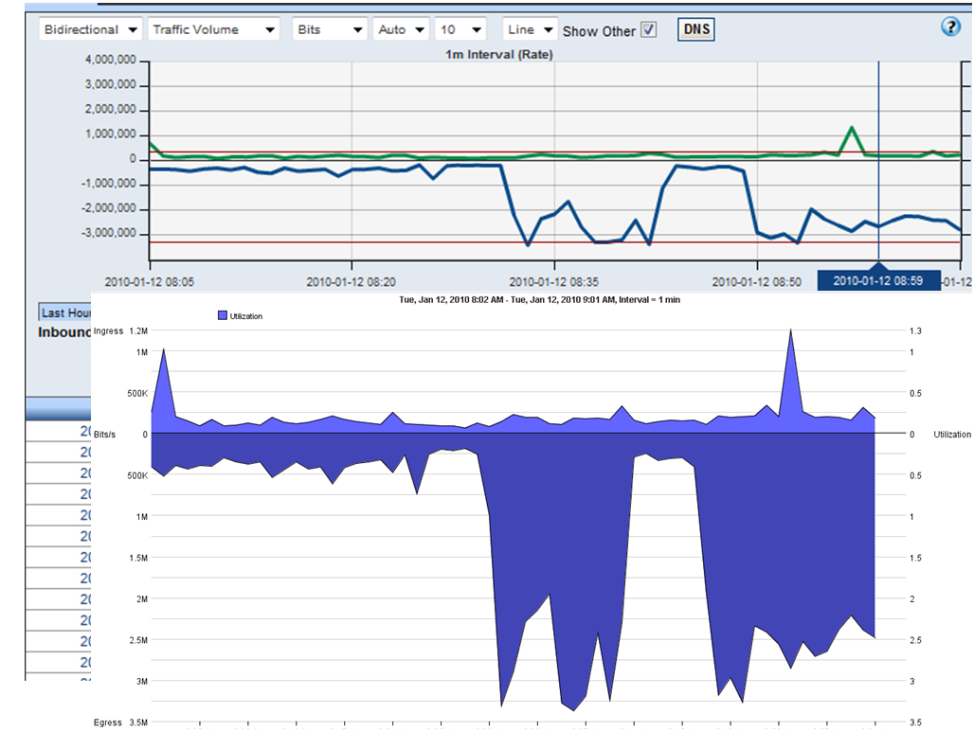
Passive - Flow
Many flavors of flow monitoring
Netflow – standard originally from Cisco and adopted by others as a general way to export aggregate IP flow statistics
sFlow – general purpose monitoring for different layers (e.g. not just network layer, can be used at layers 2 through 7).
In both cases you are getting a sampled (configurable) view of traffic patterns from the network devices. Helps to:
Identify source and destination of data flows
Sizes, durations, and types of data (e.g. protocol and sometimes application)

Slide 18
Passive - Flow
Netflow places load on the CPU of a device since it attempts to mirror all traffic, and punt it to a collection location. E.g. a high sampling rate can impact device performance
sFlow is designed be a function of an ASIC (in a switch) or a background daemon on a host. Due to a higher default sampling, this is less resource intensive.
sFlow is a relatively new technology, and not supported by all devices

Slide 19
Passive - Flow
There are many tools to collect/aggregate/analyze this data
Open Source: NTop, Flow-tools, NFDump/NFSen
Commercial: Arbor, Deepfield, InMon
Choosing should gate on what you are willing to pay, and note that open source does not mean ‘free’ given a human will have to maintain the infrastructure
Most commercial products will allow a test drive phase
Suggested that you go with something that can accept multiple formats

Slide 20
Passive - Flow
Suggested Deployment:
Centralized collector (server with big disk and many CPUs)
sFlow from all devices that can support it
All networking devices
Hosts (particularly DTNs, cluster nodes, and devices that support services [DHCP, DNS, HTTP])
Netflow from all devices that don’t support sFlow
Typically this is from things you directly control. Have conversations with peers that are operating devices outside of your control about sending the data centrally

Slide 21
Passive - Logging
Logging can take a couple of different forms:
Hosts typically log all actions via syslog
Network devices offer similar capability and tools (rancid)
Logging has not been historically useful since logs live on each machine, and it can be challenging to aggregate them all for a full picture of activity
Software to the rescue (some free, some not):
Splunk, ELK (elastic search, logstache, kabana), Graylog, Fluentd

Slide 22
Passive - Logging
N.B. Pick a solution you are comfortable with. Open source is not ‘free’ if you don’t have a person to figure out the nuances.
Suggested Deployment:
Centralized collector (sufficient CPU and storage)
Configure major services (DTNs, servers [DNS, HTTP, DHCP], etc) to send
Configure networking devices that can support it
Extra mile: analytics to alarm on anomalies

Slide 23
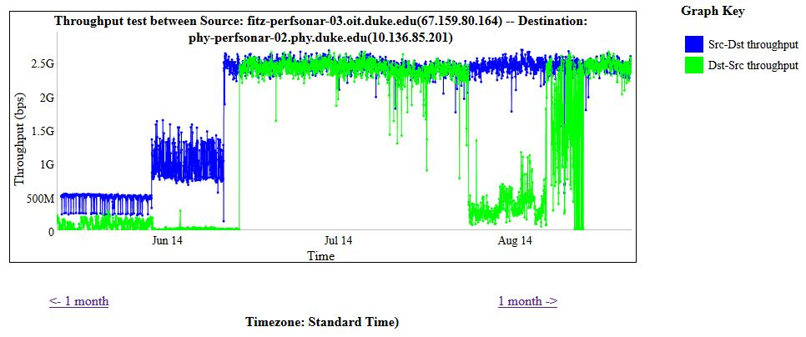
Active - perfSONAR
perfSONAR usefulness grows with number deployed
Border
High Traffic Areas
Peering Locations
Suggested deployment is to start small with a single defensible resource near a hub of activity
Can extend to more locations as time/budget/people resources increase

Slide 24
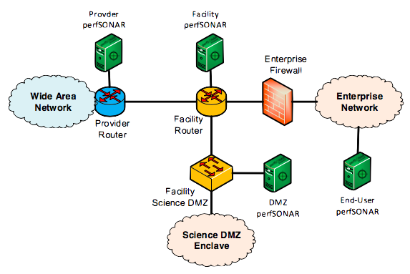
Active - perfSONAR

Slide 25
Active - perfSONAR
N.B. Items:
Don’t configure heavy bandwidth tests locally – will only cause congestion and not reveal anything you don’t already know
‘Public’ testers can be found by the public. Protect things you don’t want to be found
Configure a reasonable set of Routing/Latency/Throughput tests to locations that matter.
Upstream provider(s)
Heavy collaborators

Slide 26
Active - perfSONAR
Suggested Deployment:
Private ‘campus’ testers with a set of configured tests
To collaborators
To upstream providers
Use BWCTL limits file to block tests (e.g. not firewalls and NATed addresses)
Public tester for outside parties to use (does not need any regular tests configured)
Extra mile: participation in a regional or national ‘mesh’ of tests (e.g. http://ps-dashboard.es.net)

Slide 27
Outline
The Role of Technology
Defining Use Cases
Sensible Campus and Regional Policies

Slide 28
Defining Sensible Policies
Deployment
Data Retention
Reporting Intervals
Operational Reviews
Broader Dissemination

Slide 29
Deployment
For Centralized Services:
Future proof the purchase of hardware and software when you can
Limit the number of people with direct access (security) but encourage people to learn how it works (redundancy)
For Distributed Sensors:
Configure things to send data to the correct location, and enforce a very strict security posture on access
If something doesn’t do (or doesn’t do it well) the monitoring you need, consider upgrades

Slide 30
Data Retention
Storage is remarkably cheap, and data piles up quickly.
Decide what matters most:
Fine-grained raw data access for multiple years
Aggregated reports
Most storage tools have knobs for the retention of data. Many can keep exact data for a period of time, and slowly age it out in favor of an lower resolution view
If the data has privacy implications (e.g. flow records), take steps to protect this data

Slide 31
Reporting Intervals
Regular reports help guide certain parties:
Decision makers (e.g. facility/institution administration)
Scientific users
Engineering/IT support
Reports can be broad in nature:
Overview of ‘hot’ links and/or top talkers
Amount of data moved/received
Simple statistical analysis to fit the observation to a growth curve
A monthly or quarterly report is easily configured into common software.

Slide 32
Operational Reviews
Assistive technology can’t remain static. Set a schedule to review:
What its telling you (and if you need more or less)
If there are changes to formats or offerings (e.g. if you buy new devices, do they do different things)
Locations of coverage
Impact of the data being collected (are the right people seeing it, and is it helping assist them with their jobs)

Slide 33
Broader Dissemination
The data collected via technology should:
Guide the review process (e.g. who needs a new review, who needs to be revisited)
Guide network and technology enhancements (new services, upgraded capacity)
Fodder for other reports (CI plan, institutional impact studies, facilities overviews for solicitation responses)

Slide 34
Conclusions
Technology has an important role in understanding the impacts of science on your network and computational infrastructure
There are several use cases for how this can be applied, managed, and ultimately consumed by the users, engineering groups, and leadership
Defining policies, and refining them over time, will help deliver a better understanding of science and technology impacts

Slide 35
Gathering Requirements Using Technology
http://www.es.net/science-engagement/science-requirements-reviews/
Energy Sciences Network (ESnet)
Lawrence Berkeley National Laboratory
Jason Zurawski – zurawski@es.net
Kate Petersen – kate@es.net
RMACC Symposium and RMCMOA Workshop
August 11th 2016
© 2016, The Regents of the University of California, through Lawrence Berkeley National Laboratory (subject to receipt of any required approvals from the U.S. Dept. of Energy). All rights reserved.
NOTICE. This material is owned by the U.S. Department of Energy. As such, the U.S. Government has been granted for itself and others acting on its behalf a paid-up, nonexclusive, irrevocable, worldwide license in the material to reproduce, prepare derivative works, and perform publicly and display publicly.

Slide 36
Extra Slides

