Slide 1
Gathering Requirements Using Case Studies
http://www.es.net/science-engagement/science-requirements-reviews/
Energy Sciences Network (ESnet)
Lawrence Berkeley National Laboratory
Jason Zurawski – zurawski@es.net
Kate Petersen – kate@es.net
RMACC Symposium and RMCMOA Workshop
August 11th 2016
© 2016, The Regents of the University of California, through Lawrence Berkeley National Laboratory (subject to receipt of any required approvals from the U.S. Dept. of Energy). All rights reserved.
NOTICE. This material is owned by the U.S. Department of Energy. As such, the U.S. Government has been granted for itself and others acting on its behalf a paid-up, nonexclusive, irrevocable, worldwide license in the material to reproduce, prepare derivative works, and perform publicly and display publicly.

Slide 2
Outline
Overview of the Process
Anatomy of the Case Study
Narrative
Data Estimation
Walking Through Preparation

Slide 3
Overview of the Process
The case study is designed to provide a narrative of the science from the point of view of the scientist
There are supporting sections that can be tag-teamed:
Networking capabilities for a facility or campus
Computational and storage resources
Software used for the process of science, or the role of support
The end goal is to produce a document that represents the overall purpose and technology interplay for a given scientific project

Slide 4
Overview of the Process
The case study:
A document to be filled out primarily by the scientist with help from support staff (network, computation, software developers)
An estimate on data needs and drivers
The review
Going over the high points to find areas of interest
Making changes to best reflect the current and future needs in a open discussion
Producing a succinct final report

Slide 5
Outline
Overview of the Process
Anatomy of the Case Study
Narrative
Data Estimation
Walking Through Preparation

Slide 6
Anatomy of the Case Study
There are two primary components to this exercise
Narrative
Data Estimation
Both are provided in the form of a ‘template’ document
The template contains helper text to guide what is wanted
Template should be reviewed periodically for correctness
Items that make sense for ESnet, may not make sense for your institution. Modify as needed

Slide 7
The Narrative (Section Overview)
Title & Author Information
Background
Network and Data Architecture
Collaborators
Instruments and Facilities
Process of Science
Remote Science Activities
Software Infrastructure
Cloud Services
Outstanding Issues

Slide 8
Title & Author
Purpose: Easily identifies the science, group, or people involved in the review process.
Who this Benefits: All stakeholders (scientists, technology support, leadership). Also gives a reference for future readers and editors, if trying to place the data in the context of past work.
Comments:
Some facilities may choose to leave out a specific author – this is fine as long as a contact person can be established as a part of the process
A single facility may have multiple represented experiments. It may be worth while to treat each differently, and combine into a single facility case study

Slide 9
Background
Purpose: Provide a brief (2 paragraphs is sufficient) overview of the facility and the nature of the science being performed. Paint in broad strokes for a audience that may not be experts.
Who this Benefits: All stakeholders (scientists, technology support, leadership). Levels the playing field on what you are trying to do, and why you want to do it. The non-science stakeholders in particular will benefit from a broad understanding, so they can better suggest support in the form of technology.
Comments:
The largest mistake of this field is not being brief. Multiple pages of platitudes is not helpful for a review of this nature.
It helps to draw parallels between the science and the outcomes. E.g. a lab with a genomics sequencer may use it to better understand the ways that cancer is hereditary. Its also important to note that this is of interest to funding bodies (NSF, NIH) and private industry, etc.

Slide 10
Network & Data Architecture
Purpose:
Provide a detailed overview of how the facility connects to the world (network that is local, regional, national)
Provide information on the flow of data (from the outside in, from the inside out) and why (storage or compute, instrumentation)
Work *with* local technology people to fill in gaps the science user doesn’t know
Supply diagrams if they exist. Collaborate to create them if they don’t.
Being pedantic is helpful: get specific details about the models of devices, and how they interconnect

Slide 11
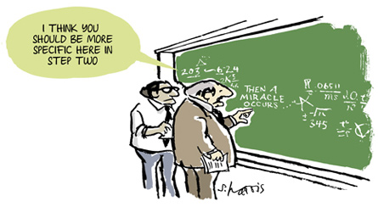
Network & Data Architecture (cont.)
Who this Benefits:
This will benefit the technology group the most. If central IT provides services only, they may be unaware of the specifics of a local infrastructure they don’t control.
The scientist may learn more about what is beyond their doorstep too – which can create ‘aha’ moments regarding successes and failures they may remember
The outcome of this section will benefit leadership (e.g. knowing something is the right or wrong size for needs)

Slide 12
Network & Data Architecture (cont.)
Comments:
Often this is the most time consuming section for a scientist. From the start, encourage collaboration. Assign an IT person to work with them on this (explaining things, looking up details). This relationship building is important.
The technology group may learn things they do not know if a facility is run as a black box. Be prepared to ask questions during the review
Lastly, gaps will be found that can be addressed later
The user may denote they are plugging all of their gear into a single 10/100 Hub that has one Ethernet connection to campus.
It may also be revealed that they are rather sophisticated in their operation and management, and are duplicating campus services

Slide 13
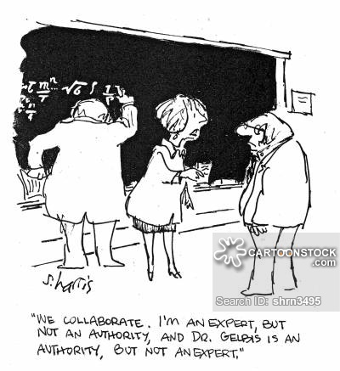
Collaborators
Purpose: Identify (broadly) the people and institutions that a science group interacts with. This could be push or pull in nature. It will certainly span countries and continents.

Slide 14
Collaborators
Who this Benefits: This benefits technology and leadership primarily. Technology can look at wide area patterns and better judge peering relationships that are, or need to be, established. Leadership can
Comments:
The most common mistake in this section is not listing sporadic collaborations. Its easy to list large things (e.g. a computational or experimental facility), its harder to remember if someone changes institutions or a new workflow exists that ships data somewhere else.
Encourage people to be specific as they consider this

Slide 15
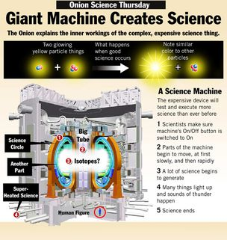
Instruments & Facilities
Purpose:
Give a specific view of both local and remote scientific instruments and facilities.
Examples of instrument (some local, some not): Genomics Sequencer, Electron Microscope, Telescopes
Examples of facilities:
Light Source (many beamlines)
XSEDE/DOE SC Center
The LHC (Tier0 @ CERN, or any number of Tier1s, Tier2s, and Tier3s)
ESGF (many distributed data nodes)

Slide 16
Instruments & Facilities (cont.)
Purpose:
In general, Instrument = thing that produces or consumes data. Facility = house for many instruments
Its important to know the scale info in this section (Present, 2-5, 5+) to understand data growth.
In addition to knowing the things being used, its helpful to know how they are used
How often per day/week/month/year
By whom (visitors, locals)
Where the data lives before, during, after
What security risks exist to the machines and or data

Slide 17
Instruments & Facilities (cont.)
Who this Benefits: This is more useful for the tech people and leadership vs. the scientists (they may know enough about the instrumentation). IT servers as a valuable record of a point in time however, in case things change in the future.
Comments:
The most common error is being afraid to commit on the timescales. Be liberal in estimates, e.g. plan like money is not an issue. This helps understand potential for growth, even if it won’t be actual growth
Any instrumentation is important, the thinks that make the science along with the things that process it (computation and storage)

Slide 18
Process of Science
Purpose:
This section is designed to explain ‘a day in the life’ of the science group. It should be the most narrative of the sections, since it is tying together the instruments, the people, and the resources.
Example (genomics):
Samples are mailed from many locations and stored in web lab
Scientific personnel in protective gear unpack and prepare samples
Genomics sequencer is started, and storage is connected (could be network, could be physical media like a DVD)
Sample takes 4 hours to process, 40TB or raw data is collected during this time
Sample is removed and discarded. Data is transferred to local storage and queued to DTN for transmission to XSEDE
Data is migrated before allocation. Allocation time is used to analyze
Analysis data is returned to local staff

Slide 19
Process of Science
Purpose:
In addition to the ‘human’ narrative, its helpful to know the machinery involved. Encourage discussion about the hardware and software used (details can be given in future sections).
A basic discussion of data sizes and migratory patterns will emerge in this, as well as during discussion.
As in the other section, its important to know the scale info in this section (Present, 2-5, 5+) to understand data growth.
Discussion about areas of friction is also encouraged, e.g. the wall clock difference between gathering the data, and sending it offsite. Or the impact that local clusters have vs. purchasing cloud computing services

Slide 20
Process of Science (cont.)
Who this Benefits: The largest beneficiary in this section is the technical staff, who can suggest technology changes to better support the scientific process. Leadership can also comment on potential tie ins to institutional and regional resources. Other science users may comment on better ways to embark on the process.
Comments:
The most common error is being afraid to commit on the timescales. Be liberal in estimates, e.g. plan like money is not an issue. This helps understand potential for growth, even if it won’t be actual growth
Sometimes critical details are left out because someone may not view them as interesting. Encourage a full treatment, and discussion can narrow down things not important.

Slide 21
Remote Science Activities
Purpose:
This section is meant to gather more detail that was not captured in the instrumentation/facilities and collaborators sections.
Who this Benefits: This benefits leadership and technical staff, with some benefits to other participating science groups. It may be the case that new use cases are derived upon hearing about the availability of remote facilities.
Comments:
People may omit this if they feel its duplicating other sections info. Its important to pull it out in some manner, and that can be done during the discussion phase if its not done during the initial writeup.

Slide 22
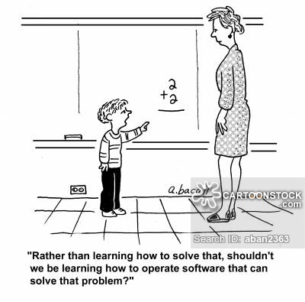
Software Infrastructure
Purpose:
This section is meant to provide more detail to the actions described in the process of science, as well as specifics related to the instruments and facilities.
Everyone uses software on a daily basis. It is important to understand use of:
Productivity/Office software (cloud based, local installs)
Communications (video or text chat)
Remote control of instrumentation (VNC, NX)
Data movement (GridFTP, Aspera, BBCP, SCP/RSYNC)
Workflow managers (Tigris, Pegasus)
HPC & HTC managers (OSG, Condor, etc.)

Slide 23
Software Infrastructure
Purpose:
From a network perspective, the data movement tools are most important, followed by how automated (e.g. workflow management) the process is. If there is full workflow support, that implies higher capacity for data handling
Identifying other services that can easily be outsourced is also of interest (e.g. if the users are using a free cloud storage service, but the school is paying for another)
The goal is to list out the major items in minimal detail. The discussion can be used to explain why things are the way they are (or how they can be improved)
Its important to know the scale info in this section (Present, 2-5, 5+) to understand data growth.

Slide 24
Software Infrastructure (cont.)
Who this Benefits: This will benefit the technology group the most, with some benefit toward leadership when it comes to planning purchases and services. Other science users may have suggestions or comments on things that work well, or don’t.
Comments:
The most common error is being afraid to commit on the timescales. Be liberal in estimates, e.g. plan like money is not an issue. This helps understand potential for growth, even if it won’t be actual growth
Most software is important, drive home this point with the science group. Details can be removed from the final report, but are necessary to add in the initial pass

Slide 25
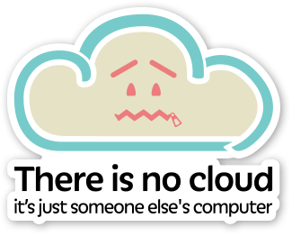
Cloud Services
Purpose: This is a specific section that goes into details that may have been missed in other sections with regards to cloud. This doesn’t have to be about just computing, it can be about storage or other services.
Who this Benefits: This will benefit leadership (to understand drivers and costs) and the technology group that has to worry about supporting the peering infrastructure. Other science groups may comment on providers that work better than others.

Slide 26
Cloud Services
Comments:
Cloud is an important evolution in science, and many will turn to it due to the ease and cost vs. using their own infrastructure. In some cases it is cheaper (e.g. the resource is needed only one time per month vs. powering a cluster every day)
Many times its used due to friction in using local, regional, or national resources. For example, one must apply to use XSEDE or DOE resources, or the local staff may not know how to use something ‘free’ like OSG computing
Use this section as a way to learn what people are doing, and as a way to start discussions about alternatives (if there are any).

Slide 27
Outstanding Issues
Purpose: Catch-all section to denote areas of success or failure. Also list out things that are not covered in other areas.
Who this Benefits: All stakeholders
Comments:
Encourage people to write ‘problems’ in this section, e.g. ‘slowness’ in data transfer, or ‘hard to use’ computing infrastructure are common examples.
During the discussion, make sure to encourage free thought and commentary.

Slide 28
Data Estimation
The other template is meant to summarize the narrative from the first part.
This will take the highlights, and give estimates on hard numbers. E.g.
Length of time desired to move data locally from instrument to machinery
Deadlines for moving data to/from remote locations
Data set sizes for a given action in the workflow
As in the first part, collaboration is a good idea

Slide 29
Outline
Overview of the Process
Anatomy of the Case Study
Narrative
Data Estimation
Walking Through Preparation

Slide 30
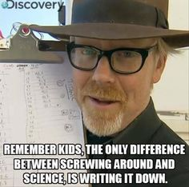
Data Estimation (Section Overview)
Key Science Drivers
Instruments, Software, and Facilities
Process of Science
Data Set Size
Network Needs
LAN Transfer Time
WAN Transfer Time
Time Scales (Present, 2-5 Years, 5+ Years)

Slide 31
Instruments, Software, Facilities
Purpose: Summarize the major outcomes from the other narrative.
Ex: The make/model/age of a microscope being used.
Ex2: The workflow software, or if none, the way that that instrumentation is used.
Ex3: The external HPC/HTC facilities commonly used, or if its all done locally
Comments:
There is rarely ‘new’ information in this section, its merely a way to denote the things from the narrative for a summary.
Be sure to list things in the appropriate time horizon entry.

Slide 32
Process of Science
Purpose: Summarize the major outcomes from the other narrative.
Don’t go into great deal, but describe how the science is done. Ideally this will build upon the previous column (the instrumentation, software, facilities) and lead into the next column on data.
In particular, there should be care taken to describe the number of times its done, etc.
Comments:
There is rarely ‘new’ information in this section, its merely a way to denote the things from the narrative for a summary.
Be sure to list things in the appropriate time horizon entry.

Slide 33
Data Set Size
Purpose: Start putting numbers on the process of science, as performed on the instrumentation/facilities/software.
This may be the first time that someone is asked to do this (they could have used abstract terms in the other narrative).
Comments:
There are no wrong answers, and it’s better to be liberal with estimates.
Rounding is appropriate, and try to list orders of magnitude (e.g. TB, PB).
Be sure to list things in the appropriate time horizon entry.

Slide 34
LAN Requirements
Purpose: The goal here is to describe the local environmental needs for networking.
This should match the sizes described in ‘data set size’, and meet the needs between the localized components of science.
For the most part, the goal is to set user expectations against technical reality. E.g. it should be feasible to move 1TB in 20 minutes on 10Gbps gear, or 3hrs on 1Gbps gear. See also: https://fasterdata.es.net/home/requirements-and-expectations
Comments:
This section should be worked on between Science and Technology, and can always be altered.
Be sure to list things in the appropriate time horizon entry.

Slide 35
WAN Requirements
Purpose: The goal here is to describe the remote environmental needs for networking.
This should match the sizes described in ‘data set size’, and meet the needs between the remote components of science.
This will only apply to things that have to come/go from the local environment.
See also: https://fasterdata.es.net/home/requirements-and-expectations
Comments:
This section should be worked on between Science and Technology, and can always be altered.
Be sure to list things in the appropriate time horizon entry.

Slide 36
A Note on Time Scales
The time scales chosen are:
‘Present’: This represents what is capable today, and with current levels of budget (e.g. if there is an immediate plan to upgrade)
‘2-5 Years’: This is typically what would happen when more funding is received (and funding can take years to materialize).
‘5+ Years’: This is typically wishful thinking based on advancements in industry and beyond the 2 funding cycles.

Slide 37
Outline
Overview of the Process
Anatomy of the Case Study
Narrative
Data Estimation
Walking Through Preparation

Slide 38
Preparation
Live Demo!
Cheat Sheet:
Walk through each section of the narrative. Describe possible answers
Walk through each section of the data summary. Describe possible answers using the narrative as a starting point.

Slide 39
Gathering Requirements Using Case Studies
http://www.es.net/science-engagement/science-requirements-reviews/
Energy Sciences Network (ESnet)
Lawrence Berkeley National Laboratory
Jason Zurawski – zurawski@es.net
Kate Petersen – kate@es.net
RMACC Symposium and RMCMOA Workshop
August 11th 2016
© 2016, The Regents of the University of California, through Lawrence Berkeley National Laboratory (subject to receipt of any required approvals from the U.S. Dept. of Energy). All rights reserved.
NOTICE. This material is owned by the U.S. Department of Energy. As such, the U.S. Government has been granted for itself and others acting on its behalf a paid-up, nonexclusive, irrevocable, worldwide license in the material to reproduce, prepare derivative works, and perform publicly and display publicly.

Slide 40
Extra Slides

