Slide 1
The Science DMZ on a Budget
Jason Zurawski – zurawski@es.net
Science Engagement Engineer, ESnet
Lawrence Berkeley National Laboratory
ENhancing CyberInfrastructure by Training and Engagement (ENCITE) Webinar
July 17th, 2015

Slide 2
Overview
(Quick) Introduction and Problem Statement
What are We Optimizing for?
Components to Address & Discussion of Costs
Scaling Up: Budgeting for Future Improvements
Conclusion
© 2015, The Regents of the University of California, through Lawrence Berkeley National Laboratory and is licensed under CC BY-NC-ND 4.0

Slide 3
Motivation
Networks are an essential part of data-intensive science
Connect data sources to data analysis
Connect collaborators to each other
Enable machine-consumable interfaces to data and analysis resources (e.g. portals), automation, scale
Performance is critical
Exponential data growth
Constant human factors
Data movement and data analysis must keep up
Effective use of wide area (long-haul) networks by scientists has historically been difficult
© 2015, The Regents of the University of California, through Lawrence Berkeley National Laboratory and is licensed under CC BY-NC-ND 4.0
Notes:
Human factors – attention span, ability to manage complexity – these are constant
There is a huge amount of promise in data-intensive science. Effective use of networks can help realize those benefits.
The Science DMZ model helps address the difficulties scientists often experience with using networks.

Slide 4
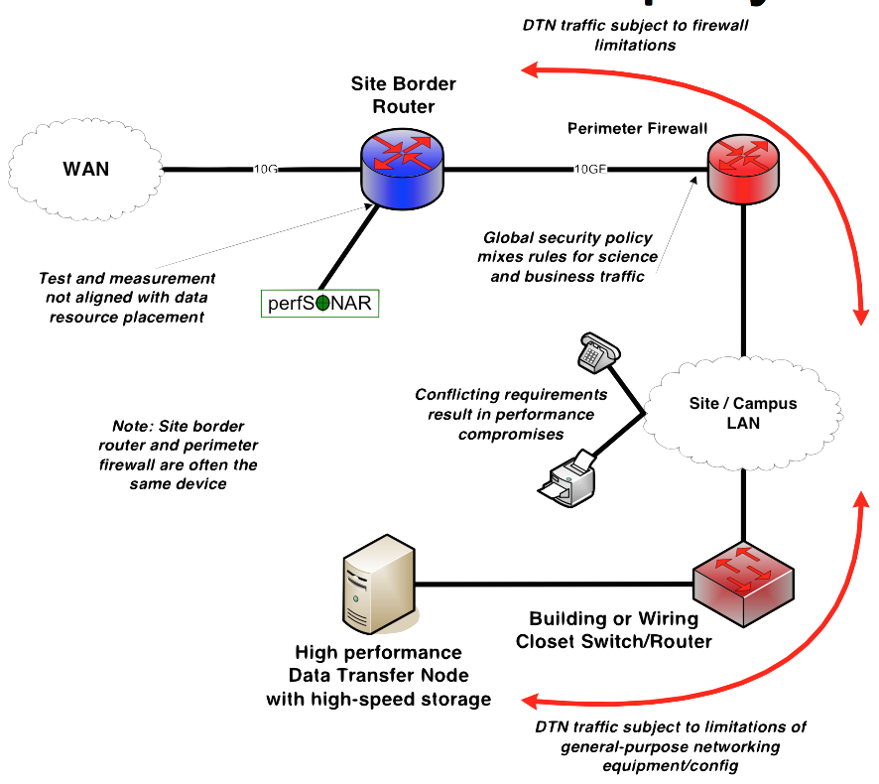
The Wrong Way
This is often what gets tried first
Data transfer node deployed where the owner has space
This is often the easiest thing to do at the time
Straightforward to turn on, hard to achieve performance
If present, perfSONAR is at the border
Entire LAN path has to be sized for data flows
Entire LAN path is part of any troubleshooting exercise
This usually fails to provide the necessary performance.
© 2015, The Regents of the University of California, through Lawrence Berkeley National Laboratory and is licensed under CC BY-NC-ND 4.0
Notes:
Call this a ‘converged’ network, its what your local vendor rep will try to sell you
Converged does not work for science – and we can point to the insertion of a fully tuned DTN host as the counter case. The host can work well, but the network won’t due to things like congestion, buffering, security devices, etc.
This is what frustrates users most of all – they bought a new $20k server to run a high-performance tool, and they will be very mad when they get the same performance they would out of something 10 years old using SCP.

Slide 5
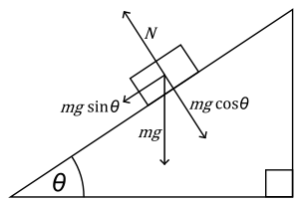
The Science DMZ in 1 Slide
Consists of three key components, all required:
“Friction free” network path
Highly capable network devices (wire-speed, deep queues)
Virtual circuit connectivity option
Security policy and enforcement specific to science workflows
Located at or near site perimeter if possible
Dedicated, high-performance Data Transfer Nodes (DTNs)
Hardware, operating system, libraries all optimized for transfer
Includes optimized data transfer tools such as Globus Online and GridFTP
Performance measurement/test node
perfSONAR
Engagement with end users
Details at http://fasterdata.es.net/science-dmz/
© 2013 Wikipedia
© 2015, The Regents of the University of California, through Lawrence Berkeley National Laboratory and is licensed under CC BY-NC-ND 4.0
Notes:
Single slide summary

Slide 6
…but
There are costs associated with all of this
Servers (DTN, perfSONAR) are expensive. So are software licenses for data movement tools
Router/Switch upgrades can get expensive depending on the speeds required and number to be purchased
Humans need to install all of this, and them maintain it long term
This talk will discuss some of these costs and prioritize behaviors that are cost effective
This isn’t about getting it all for ‘free’
This is about being smart with a limited budget to address the items that will help guarantee success
Some problems can only be solved with $, others can be partially addressed with time and effort
© 2015, The Regents of the University of California, through Lawrence Berkeley National Laboratory and is licensed under CC BY-NC-ND 4.0

Slide 7
Overview
(Quick) Introduction and Problem Statement
What are We Optimizing for?
Components to Address & Discussion of Costs
Scaling Up: Budgeting for Future Improvements
Conclusion
© 2015, The Regents of the University of California, through Lawrence Berkeley National Laboratory and is licensed under CC BY-NC-ND 4.0

Slide 8
What are We Optimizing for?
The goal of the Science DMZ enclave is to improve the outcomes of science by making use of a network a ‘non factor’:
Applications and servers for data movement activities that Just Work ™
Migration of science flows to a network path that:
Is free of enterprise congestion
Is capable of delivering line rate bursts from the science gear
Security posture that is ‘right sized’ for the application/use case
Performance is predictable and verifiable
Lets dig in deeper on these … but lets also remember our friend TCP
© 2015, The Regents of the University of California, through Lawrence Berkeley National Laboratory and is licensed under CC BY-NC-ND 4.0

Slide 9
TCP – Ubiquitous and Fragile
Networks provide connectivity between hosts – how do hosts see the network?
From an application’s perspective, the interface to “the other end” is a socket
Communication is between applications – mostly over TCP
TCP – the fragile workhorse
TCP is (for very good reasons) timid – packet loss is interpreted as congestion
Packet loss in conjunction with latency is a performance killer
Like it or not, TCP is used for the vast majority of data transfer applications (more than 95% of ESnet traffic is TCP)
© 2015, The Regents of the University of California, through Lawrence Berkeley National Laboratory and is licensed under CC BY-NC-ND 4.0
Notes:
The application sees the network as a socket.
The socket interface does not provide path diagnostics or other troubleshooting information.
TCP behaves as it does because of measures taken in the 1980s to fix the congestion collapse of the Internet
TCP makes a promise to the application – TCP will get the data to the other end, or TCP will return an error. TCP makes no promises about performance.

Slide 10
A small amount of packet loss makes a huge difference in TCP performance
With loss, high performance beyond metro distances is essentially impossible
Local
(LAN)
International
Metro Area
Regional
Continental
Measured (TCP Reno)
Measured (HTCP)
Theoretical (TCP Reno)
Measured (no loss)
© 2015, The Regents of the University of California, through Lawrence Berkeley National Laboratory and is licensed under CC BY-NC-ND 4.0
Notes:
This is an annotated version of the plot from the Science DMZ paper
Beyond your metro area, zero loss is essentially required for high performance
Where are your collaborators? Where are your users?
When global collaboration is the norm, nobody can afford to be a local-only resource

Slide 11
Thoughts on Optimizing for Cost
Network Architecture
Going ‘new and cheap’ is worse than ‘old and functional’
Wants: Line rate performance, deep tunable buffers, diagnostics
Avoids: ‘special’ features for non-issues (e.g. integration with enterprise tech)
Security
Targeted security for the use cases – not blanket security. We will spend human time on the first, and we save on tech cost as a result
Wants: A succinct study of the data, actors, requirements, and risks. Network infrastructure with the ability to filter/block versus a dedicated appliance
Avoids: ‘1 size fits all’ solutions, and anything that is designed for an enterprise work load.
© 2015, The Regents of the University of California, through Lawrence Berkeley National Laboratory and is licensed under CC BY-NC-ND 4.0

Slide 12
Thoughts on Optimizing for Cost
Data Transfer
Simple & Straightforward solution for the task of data movement. Combination of hardware and software
Wants: Machines that can push/receive data at near line rate (proper tuning of network, storage, and software needed), located near campus border to circumvent LAN complications
Avoids: Solutions based on old technology (SSH/RSYNC), or anything that the end user isn’t comfortable with
Performance Monitoring
Visibility into end to end network performance between local users and remote resources
Wants: Dedicated machines to handle this job, integration with visualizations to see results over time
Avoids: Virtualized testers, ‘over’ monitoring, sharing machinery with other jobs to do
© 2015, The Regents of the University of California, through Lawrence Berkeley National Laboratory and is licensed under CC BY-NC-ND 4.0

Slide 13
Overview
(Quick) Introduction and Problem Statement
What are We Optimizing for?
Components to Address & Discussion of Costs
Scaling Up: Budgeting for Future Improvements
Conclusion
© 2015, The Regents of the University of California, through Lawrence Berkeley National Laboratory and is licensed under CC BY-NC-ND 4.0

Slide 14
Network Path
We ideally want:
A network path that is not oversubscribed/free of congestion
E.g. the ‘fan in’ is a factor – if you have 10 x 1Gbps machines that could operate concurrently, there should be at least 1 x 10Gbps egress (if not more)
Is buffered enough to support large flows
Science traffic isn’t a heard of mice, it’s a small to medium number of elephants. Buffering (especially on aggregation devices) is required to make sure we don’t drop traffic and impact TCP
Is as ‘close’ to the WAN as possible
Reducing ‘hop count’ is good for many reasons: it removes the possibility of congesting the core network, it eliminates locations of failure, and it simplifies the path.
© 2015, The Regents of the University of California, through Lawrence Berkeley National Laboratory and is licensed under CC BY-NC-ND 4.0

Slide 15
Multiple Ingress Flows, Common Egress
Hosts will typically send packets at the speed of their interface (1G, 10G, etc.)
Instantaneous rate, not average rate
If TCP has window available and data to send, host sends until there is either no data or no window
Hosts moving big data (e.g. DTNs) can send large bursts of back-to-back packets
This is true even if the average rate as measured over seconds is slower (e.g. 4Gbps)
On microsecond time scales, there is often congestion
Router or switch must queue packets or drop them
© 2015, The Regents of the University of California, through Lawrence Berkeley National Laboratory and is licensed under CC BY-NC-ND 4.0
Notes:
A brief introduction to the impacts of buffering on network traffic. Key points:
- Host interfaces ‘burst’ at line rate, and then wait (e.g. it’s binary behavior, not a nice steady pacing at some average rate)
- multiple ingress flows behave differently depending on the architecture of the switch. If its ‘shared’ memory, all may be using the same memory buffer. If each interface has its own, then 1 or 2 bursting may be less impactful on the rest of the interfaces.
- buffer bloat is typically not a concern in a Science DMZ

Slide 16
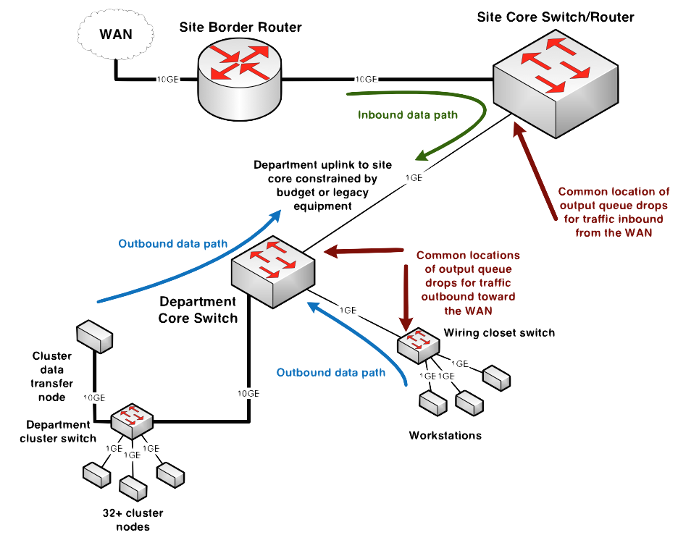
Output Queue Drops – Common Locations
© 2015, The Regents of the University of California, through Lawrence Berkeley National Laboratory and is licensed under CC BY-NC-ND 4.0
Notes:
In the outbound direction, traffic from the cluster goes from 10G to 1G on the department core switch – the 10G DTN will burst, causing loss if the 1G output queue is too shallow
In the outbound direction, many 1G workstations can congest a single 1G uplink port
In the inbound direction, 10G of WAN traffic goes to a 1G port facing the department core switch – likely loss location (and on the wide area path to the DTN!)
There are a lot of networks with this sort of problem.
The best way to find the problem is to use perfSONAR

Slide 17
Components to Address – Network Devices & Design
Interface output queue allows the router or switch to avoid causing packet loss in cases of momentary congestion
In network devices, queue depth (buffer) is often a function of cost
Inexpensive, fixed-config LAN/datacenter switches (especially in the 10G space) have inadequate buffering. Could be shared between all interfaces, or a small fixed amount per interface
Cut-through or low-latency Ethernet switches typically have inadequate buffering (the whole point is to avoid queuing!)
Expensive, chassis-based devices are more likely to have deep enough queues
Juniper MX and Alcatel-Lucent 7750 used in ESnet backbone
Other vendors make such devices as well - details are important
Thx to Jim: http://people.ucsc.edu/~warner/buffer.html
This expense is one driver for the Science DMZ architecture – only deploy the expensive features where necessary
© 2015, The Regents of the University of California, through Lawrence Berkeley National Laboratory and is licensed under CC BY-NC-ND 4.0

Slide 18
Components to Address – Network Devices & Design
Deep interface queues – this matters and may cost $ if you don’t have it …
Output queue or VOQ – doesn’t matter
What TCP sees is what matters – fan-in is *not* your friend
No, this isn’t buffer bloat
Good counters
We like the ability to reliably count *every* packet associated with a particular flow, address pair, etc
Very helpful for debugging packet loss
Must not affect performance (just count it, don’t punt it)
sflow support if possible
If the box is going to drop a packet, it should increment a counter somewhere indicating that it dropped the packet
Where are counters – ingress and egress. What happens if the packet is dropped within the fabric?
Magic vendor permissions and hidden commands should not be necessary – but may be all you get
Single-flow performance should be wire-speed
© 2015, The Regents of the University of California, through Lawrence Berkeley National Laboratory and is licensed under CC BY-NC-ND 4.0

Slide 19
Components to Address – Network Devices & Design
Verification
IMIX (Internet Mix) is the standard ‘test’ of traffic put through devices – this is what the glossy sales brochure is based on
Web/Email. Small in size flows, short lived, many
R&E Mix (especially science flows) is different
Larger flows, longer lived, fewer
Bugs happen – but you need a way to accurately know when they happen
Data integrity (traffic forwarded, but with altered data payload)
Packet loss – hopefully that is being counted somewhere
Interface wedge
Optical “flap”
Monitoring systems are indispensable
Finding and fixing issues is sometimes hard
Rough guess – difficulty exponent is degrees of freedom
Vendors/platforms, administrative domains, time zones
Takeaway – don’t skimp on test gear (at least maintain your perfSONAR boxes for 1Gbps to 40Gbps, 100Gbps is harder and should be done with a hardware tester [Spirent, IXIA, etc])
© 2015, The Regents of the University of California, through Lawrence Berkeley National Laboratory and is licensed under CC BY-NC-ND 4.0

Slide 20
Network Path Costs
Devices & Architectural Changes
Optical/copper connection off of the border device to segment off the DMZ network
“Can I use device X”. This depends on if “X” has the horsepower to sustain a line rate flow from your DTN.
Most times you do not need a ½ million dollar core router/switch. You will need to do better than a 1U datacenter device.
Always ask for an evaluation unit if you are buying new
Set up a small testbed if you are recycling – monitor the queues and run some tests from your DTN/perfSONAR nodes. Simulate fan in congestion, etc.
Operations
Really no different than other devices. You will want a dedicated config for the science network gear (e.g. bigger buffers, different QoS)
© 2015, The Regents of the University of California, through Lawrence Berkeley National Laboratory and is licensed under CC BY-NC-ND 4.0

Slide 21
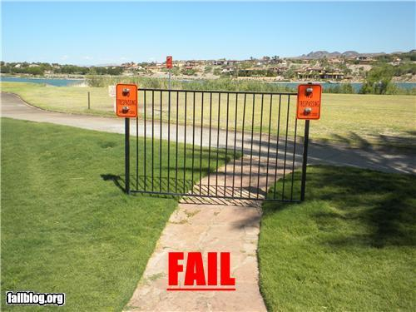
Science DMZ Security
Goal – disentangle security policy and enforcement for science flows from security for business systems
Rationale
Science data traffic is simple from a security perspective
Narrow application set on Science DMZ
Data transfer, data streaming packages
No printers, document readers, web browsers, building control systems, financial databases, staff desktops, etc.
Security controls that are typically implemented to protect business resources often cause performance problems
Separation allows each to be optimized
© 2015, The Regents of the University of California, through Lawrence Berkeley National Laboratory and is licensed under CC BY-NC-ND 4.0

Slide 22
Placement Outside the Firewall
The Science DMZ resources are placed outside the enterprise firewall for performance reasons
The meaning of this is specific – Science DMZ traffic does not traverse the firewall data plane
Packet filtering is fine – just don’t do it with a firewall
Lots of heartburn over this, especially from the perspective of a conventional firewall manager
Lots of organizational policy directives mandating firewalls
Firewalls are designed to protect converged enterprise networks
Why would you put critical assets outside the firewall???
The answer is that firewalls are typically a poor fit for high-performance science applications
© 2015, The Regents of the University of California, through Lawrence Berkeley National Laboratory and is licensed under CC BY-NC-ND 4.0
Notes:
Packets do not traverse a firewall device
Firewalls are typically engineered very differently than routers and switches

Slide 23
Firewall Performance Example
Observed performance, via perfSONAR, through a firewall:
Observed performance, via perfSONAR, bypassing firewall:
Almost 20 times slower through the firewall
Huge improvement without the firewall
© 2015, The Regents of the University of California, through Lawrence Berkeley National Laboratory and is licensed under CC BY-NC-ND 4.0
Notes:
Real life example, in front of and in back of a firewall that was dramatically impacting performance
perfSONAR is good at finding these issues
Engineers still have to take action to fix the problem

Slide 24
A word on Firewall Internals
A firewall protects against the unknown – e.g. all interactions are reduced to someone on one side trying to do something on the other
These are great when you do not know the behavior and work best for the calamity of an enterprise world
Science traffic patterns are well known in terms of applications, ports, and networks
Typical firewalls are composed of a set of processors which inspect traffic in parallel
Traffic distributed among processors such that all traffic for a particular connection goes to the same processor
Simplifies state management
Parallelization scales deep analysis
Excellent fit for enterprise traffic profile
High connection count, low per-connection data rate
Complex protocols with embedded threats
Each processor is a fraction of firewall link speed
Significant limitation for data-intensive science applications
Overload causes packet loss – performance crashes
© 2015, The Regents of the University of California, through Lawrence Berkeley National Laboratory and is licensed under CC BY-NC-ND 4.0
Notes:
Each individual processor is typically a fraction of link speed (e.g. eight 1.25Gbps processors for a 10G firewall)

Slide 25
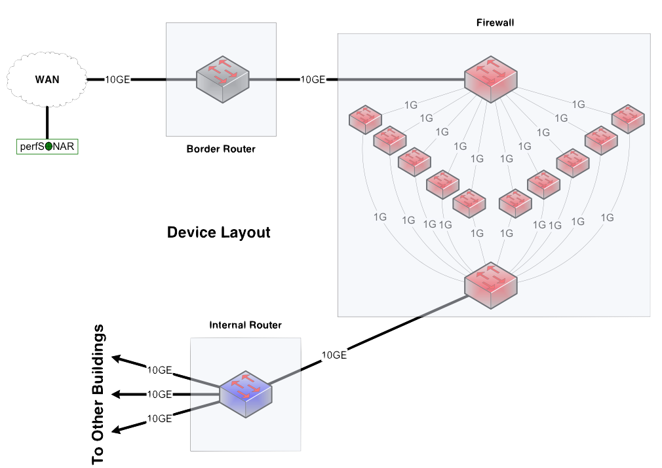
Notional 10G Network Between Devices
© 2015, The Regents of the University of California, through Lawrence Berkeley National Laboratory and is licensed under CC BY-NC-ND 4.0
Notes:
Now, convert the buildings into network devices
Building A becomes a border router
Building B becomes a firewall
Building C becomes a core router

Slide 26
Firewall Capabilities and Science Traffic
Firewalls have a lot of sophistication in an enterprise setting
Application layer protocol analysis (HTTP, POP, MSRPC, etc.)
Built-in VPN servers
User awareness
This adds cost to the mix …
Data-intensive science flows typically don’t match this profile
Common case – data on filesystem A needs to be on filesystem Z
Data transfer tool verifies credentials over an encrypted channel
Then open a socket or set of sockets, and send data until done (1TB, 10TB, 100TB, …)
One workflow can use 10% to 50% or more of a 10G network link
© 2015, The Regents of the University of California, through Lawrence Berkeley National Laboratory and is licensed under CC BY-NC-ND 4.0

Slide 27
Security Without Firewalls
Data intensive science traffic interacts poorly with firewalls
Does this mean we ignore security? NO!
We must protect our systems
We just need to find a way to do security that does not prevent us from getting the science done
Key point – security policies and mechanisms that protect the Science DMZ should be implemented so that they do not compromise performance
Traffic permitted by policy should not experience performance impact as a result of the application of policy
© 2015, The Regents of the University of California, through Lawrence Berkeley National Laboratory and is licensed under CC BY-NC-ND 4.0

Slide 28
Components to Address – Security Posture
“Security controls should enhance the utility of science infrastructure.”
Right sizing security means:
Being cognizant of the risks that are present
Being knowledgeable of the mitigation strategies
Being aware of the the implications after a strategy is employed to address a risk/risks
Notice that in the prior set of points – I didn’t say the word ‘firewall’
Security cannot be addressed with a single product/service
Security for a campus is a system, and with any system it can get complex. E.g. Layers, roles, responsibilities
© 2015, The Regents of the University of California, through Lawrence Berkeley National Laboratory and is licensed under CC BY-NC-ND 4.0

Slide 29
Components to Address – Security Posture
3 major components to the security of the cyber world:
Data
Identifying PII (where it lives, who has access, etc.) & things that are not PII
Securing the PII (encryption at rest or in motion – AAA, etc.) & allowing the non-PII to be treated differently
Computing Infrastructure
Controlling access, corruption, and unauthorized use (attack vector)
Network Infrastructure
Visibility: Knowing what regular traffic looks like, and stopping things that are anomalous
Controlling access without hindering regular use
Remember – LAYERS!
© 2015, The Regents of the University of California, through Lawrence Berkeley National Laboratory and is licensed under CC BY-NC-ND 4.0

Slide 30
Firewalls As Access Lists
When you ask a firewall administrator to allow data transfers through the firewall, what do they ask for?
IP address of your host
IP address of the remote host
Port range
That looks like an ACL to me!
No special config for advanced protocol analysis – just address/port
Router ACLs are better than firewalls at address/port filtering
ACL capabilities are typically built into the router
Router ACLs typically do not drop traffic permitted by policy
© 2015, The Regents of the University of California, through Lawrence Berkeley National Laboratory and is licensed under CC BY-NC-ND 4.0
Notes:
Remember – we have mission requirements for high performance scientific data mobility, and business requirements for cost efficiency.
A firewall mandate is an expensive solution that is a poor match for the task at hand and jeopardizes the scientific mission of the organization.

Slide 31
Security Costs
Do not buy a 1 million dollar firewall that can handle 10Gbps flows and knows what peer to peer traffic looks like. This is not a wise investment for the science network.
Devices:
Learn how to use the ACLs on your either your border device, or your science DMZ device. Rule evaluation in silicon is faster than any firewall
If you are going to go an IDS server/appliance route – budget for a beefy server an an optical tap
If you aren’t – learn to use the open source tools on each of the servers you expose in the DMZ. Its not the same, but it gives you similar functionality
Maintenance:
Mostly network engineer time to maintain ACLs/Linux admin time to install/monitor the IDS infrastructure
Divide out the PII from the non – and protect each differently
© 2015, The Regents of the University of California, through Lawrence Berkeley National Laboratory and is licensed under CC BY-NC-ND 4.0
Notes:
Remember – TCP promises reliable data delivery, not performance
In order for scientists to see high-performance correct behavior consistently, network engineers must be able to find and fix problems quickly.
Waiting around for trouble tickets is clearly the wrong approach
Not all problems are immediately obvious – many are known as “soft failures”

Slide 32
Addressing Data Movement – Data Transfer Node & Tools
The Data Transfer Node (DTN) is dedicated to data transfer
Set up specifically for high-performance data movement
System internals (BIOS, firmware, interrupts, etc.)
Network stack
Storage (global filesystem, Fibrechannel, local RAID, etc.)
High performance tools
No extraneous software
Limitation of scope and function is powerful
No conflicts with configuration for other tasks
Small application set makes cybersecurity easier
© 2015, The Regents of the University of California, through Lawrence Berkeley National Laboratory and is licensed under CC BY-NC-ND 4.0
Notes:
All aspects of the DTN must be tuned – even the BIOS matters
Limit the scope of the DTN as well – its job is data movement, its job is not to have office software on it.
Craft a specific security profile/policy around its only task.

Slide 33
Data Movement Server Costs
The underlying hardware is key – there is an inflection point between cost and performance. Typical expenses:
Chassis, power, motherboard, CPU:
Higher clock rate is better (3Ghz +), optimize on this versus number of cores
Motherboard should have adequate PCI support (gen 3, x8 or x16 lanes available) to support RAID/NIC
Memory (RAM and Disk):
More is better (for both)
The cost of OTS spinning hard drives remains constant as the capacity increases.
Spend more on a performance optimized RAID card if you can.
SSDs are expensive and will get you above a certain performance threshold - often not needed
Networking:
The cost of 10Gbps interfaces is dropping – use of copper (vs. optical) interconnects is possible too
40G is still expensive, 100G isn't a reality (yet).
Multiple cards if you anticipate reading/writing concurrently
© 2015, The Regents of the University of California, through Lawrence Berkeley National Laboratory and is licensed under CC BY-NC-ND 4.0

Slide 34
Data Transfer Tool Comparison
In addition to the network, using the right data transfer tool is critical
Data transfer test from Berkeley, CA to Argonne, IL (near Chicago). RTT = 53 ms, network capacity = 10Gbps.
Tool Throughput
scp: 140 Mbps
HPN patched scp: 1.2 Gbps
ftp 1.4 Gbps
GridFTP, 4 streams 5.4 Gbps
GridFTP, 8 streams 6.6 Gbps
Note that to get more than 1 Gbps (125 MB/s) disk to disk requires properly engineered storage (RAID, parallel filesystem, etc.)
© 2015, The Regents of the University of California, through Lawrence Berkeley National Laboratory and is licensed under CC BY-NC-ND 4.0
Notes:
Comparison of legacy and recommended tools.
Note that rsync over HPN-SSH is reasonable in a 1Gbps environment – if you are stuck with rsync over SSH, at least use HPN-SSH.
Globus is now deployed at a large number of major scientific sites – the basic data transfer functionality is free.

Slide 35
Data Movement Software Costs
Software
Most is OpenSource (e.g. GridFTP, FDT, etc.)
Some have a cost for the software (Aspera) or may have a service plan for support (Globus)
Operations
Human beings are still needed to maintain a couple of these things:
Server: Typical linux serer admin – you will want this managed by a cf manager
Storage: If your DTN is self contained, roll this into the above. If it’s a part of a larger SAN, you may need someone who can drive that (hardware maintenance, tuning, etc.)
Software: Typical linux admin tasks – maybe some knowledge of file system tuning and user management.
© 2015, The Regents of the University of California, through Lawrence Berkeley National Laboratory and is licensed under CC BY-NC-ND 4.0

Slide 36
Performance Monitoring
Everything may function perfectly when it is deployed
Eventually something is going to break
Networks and systems are complex
Bugs, mistakes, …
Sometimes things just break – this is why we buy support contracts
Must be able to find and fix problems when they occur
Must be able to find problems in other networks (your network may be fine, but someone else’s problem can impact your users)
TCP was intentionally designed to hide all transmission errors from the user:
“As long as the TCPs continue to function properly and the internet system does not become completely partitioned, no transmission errors will affect the users.” (From RFC793, 1981)
© 2015, The Regents of the University of California, through Lawrence Berkeley National Laboratory and is licensed under CC BY-NC-ND 4.0
Notes:
Remember – TCP promises reliable data delivery, not performance
In order for scientists to see high-performance correct behavior consistently, network engineers must be able to find and fix problems quickly.
Waiting around for trouble tickets is clearly the wrong approach
Not all problems are immediately obvious – many are known as “soft failures”

Slide 37
Soft Network Failures – Hidden Problems
Hard failures are well-understood
Link down, system crash, software crash
Traditional network/system monitoring tools designed to quickly find hard failures
Soft failures result in degraded capability
Connectivity exists
Performance impacted
Typically something in the path is functioning, but not well
Soft failures are hard to detect with traditional methods
No obvious single event
Sometimes no indication at all of any errors
Independent testing is the only way to reliably find soft failures
© 2015, The Regents of the University of California, through Lawrence Berkeley National Laboratory and is licensed under CC BY-NC-ND 4.0
Notes:
If something is down hard, it’s easy to find
Soft failures are often visible only from the end systems
This is what makes perfSONAR so valuable – it behaves as an end system behaves, but it measures what the network does
Remember – we want to find the problems BEFORE the users do

Slide 38
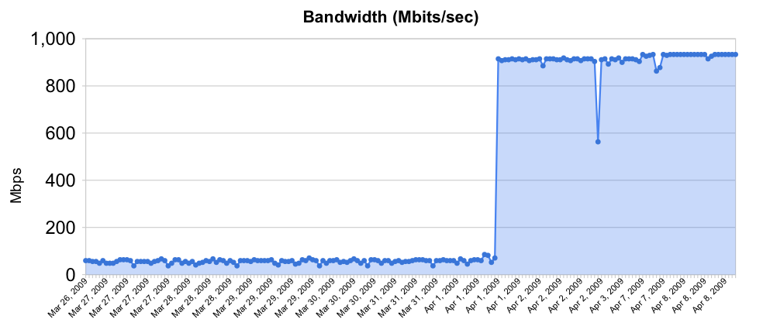
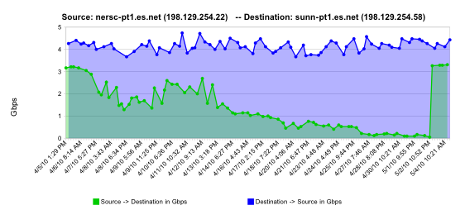
Sample Soft Failures
Rebooted router with full route table
normal performance
Gb/s
degrading performance
Gradual failure of optical line card
repair
one month
© 2015, The Regents of the University of California, through Lawrence Berkeley National Laboratory and is licensed under CC BY-NC-ND 4.0
Notes:
2 quick examples of soft failures:
The first of these was a Cisco 6509 that had over-filled its route table due to a misconfiguration, but the config had been fixed. The performance problem persisted until the router was rebooted. This could not have been found by auditing the configuration.
The second is a relatively common problem – in a big network there are a lot of pluggable optics packs, and sometimes they just go bad. Often they cause performance problems (soft failure) for a long time before they finally die (hard failure)

Slide 39
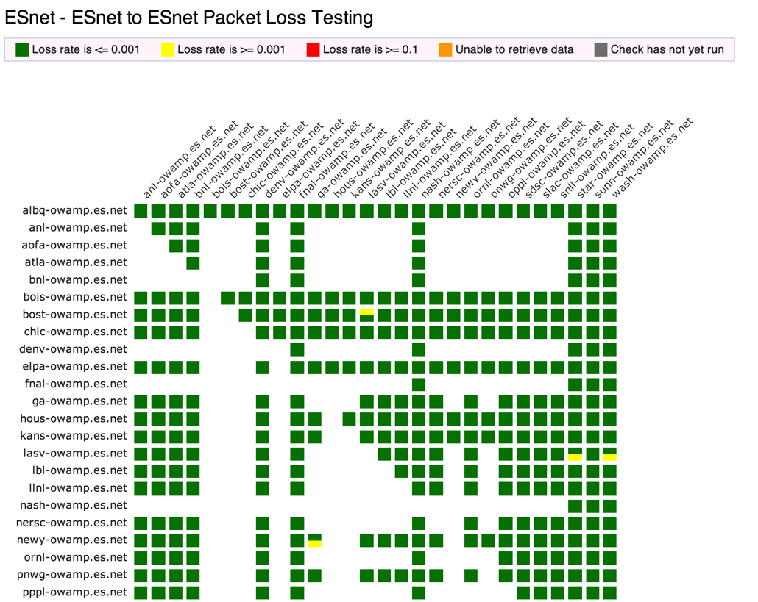
perfSONAR Dashboard: http://ps-dashboard.es.net
© 2015, The Regents of the University of California, through Lawrence Berkeley National Laboratory and is licensed under CC BY-NC-ND 4.0
Notes:
Integrating regular testing into a visualization (ESnet example).
Performance data is public
The tool can trigger alerts to notify NOC staff.
This is a very valuable tool for setting expectations

Slide 40
Performance Monitoring Costs
perfSONAR DOES NOT need a brand new multi-thousand dollar server. perfSONAR should be run on a server though, and not a VM
Devices:
Recycle an old server (you can get away with sub 2Ghz performance for 1G testing – 2-3 Ghz for 10G)
See https://www.perfsonar.net/deploy/hardware-selection/deployment-examples/ for examples if you are buying new, including a $500 config for 1Gbps testing
Maintenance:
Linux CF management is the same as with other devices – so that can be considered overhead
If you are going to use a dashboard – allocate time per week to install/maintain the results.
© 2015, The Regents of the University of California, through Lawrence Berkeley National Laboratory and is licensed under CC BY-NC-ND 4.0
Notes:
perfSONAR is the gold standard tool for performance testing, measurement, and interdomain troubleshooting in science networks

Slide 41
Overview
(Quick) Introduction and Problem Statement
What are We Optimizing for?
Components to Address & Discussion of Costs
Scaling Up: Budgeting for Future Improvements
Conclusion
© 2015, The Regents of the University of California, through Lawrence Berkeley National Laboratory and is licensed under CC BY-NC-ND 4.0

Slide 42
Scaling Up: Budgeting for Future Improvements
If you had a million dollars – what would you spend it on?
Networking
Security
Monitoring
Data Transfer
Note that the proper answer depends heavily on your network and what you spent with your limited previous funds
Opinions/hearsay/conjecture follow
© 2015, The Regents of the University of California, through Lawrence Berkeley National Laboratory and is licensed under CC BY-NC-ND 4.0

Slide 43
Scaling Up: Networking
“Bigger” is what you would aim for here:
Larger pipe to the R&E network
Larger device to accept your larger pipe
All the same lessons from before apply related to deep queues, and a science configuration
Scaling out to the rest of campus
If you carved out the DMZ, and it lives off of the border router only – maybe dedicate some fiber resources to other facilities (labs, HPC)
Upgrading campus cable plant can be costly, as well as devices in the path
© 2015, The Regents of the University of California, through Lawrence Berkeley National Laboratory and is licensed under CC BY-NC-ND 4.0

Slide 44
Scaling Up: Security
Intrusion Detection Systems (IDS)
One example is Bro – http://bro-ids.org/
Bro is high-performance and battle-tested
Bro protects several high-performance national assets
Bro can be scaled with clustering: http://www.bro-ids.org/documentation/cluster.html
Other IDS solutions are available also
Netflow and IPFIX can provide intelligence, but not filtering
Openflow and SDN
Using Openflow to control access to a network-based service seems pretty obvious
This could significantly reduce the attack surface for any authenticated network service
This would only work if the Openflow device had a robust data plane
© 2015, The Regents of the University of California, through Lawrence Berkeley National Laboratory and is licensed under CC BY-NC-ND 4.0

Slide 45
Scaling Up: Monitoring
This may category may be the least of your concerns.
Homogenous testers – same hardware/config all over your network
More of them – most useful for remote locations
Integration with trouble ticket/monitoring systems (more of a software development cost)
Customized reports (also a software development cost)
© 2015, The Regents of the University of California, through Lawrence Berkeley National Laboratory and is licensed under CC BY-NC-ND 4.0

Slide 46
Scaling Up: Data Movement
A brand new DTN with the latest/greatest costs about $25k
See: https://fasterdata.es.net/science-dmz/DTN/reference-implementation/
As your needs increase …
More ‘gateways’, e.g. split the load between multiple servers
A SAN network to link external storage around campus
Additional network cards to plug the DTN into the SAN (internal and external facing paths)
Admins to monitor the prior items
© 2015, The Regents of the University of California, through Lawrence Berkeley National Laboratory and is licensed under CC BY-NC-ND 4.0

Slide 47
Overview
(Quick) Introduction and Problem Statement
What are We Optimizing for?
Components to Address & Discussion of Costs
Scaling Up: Budgeting for Future Improvements
Conclusion
© 2015, The Regents of the University of California, through Lawrence Berkeley National Laboratory and is licensed under CC BY-NC-ND 4.0

Slide 48
Conclusions
The Science DMZ has costs associated with it
These costs are divided amongst the 4 major components
Don’t go ‘cheap’, map out what you want, want you can do, and how you will maintain it over time
Optimize for the 0-2 year/2-5 year, etc. timescale
Once you have evidence of improvement (e.g. from your monitoring), use that as the driver for more funding
© 2015, The Regents of the University of California, through Lawrence Berkeley National Laboratory and is licensed under CC BY-NC-ND 4.0

Slide 49
Links
ESnet fasterdata knowledge base
http://fasterdata.es.net/
Science DMZ paper
http://www.es.net/assets/pubs_presos/sc13sciDMZ-final.pdf
Science DMZ email list
https://gab.es.net/mailman/listinfo/sciencedmz
perfSONAR
http://fasterdata.es.net/performance-testing/perfsonar/
http://www.perfsonar.net
© 2015, The Regents of the University of California, through Lawrence Berkeley National Laboratory and is licensed under CC BY-NC-ND 4.0

Slide 50
The Science DMZ on a Budget
This document is a result of work by ESnet for the Fasterdata knowledgebase (http://fasterdata.es.net) and is licensed under CC BY-NC-ND 4.0 (https://creativecommons.org/licenses/by-nc-nd/4.0/).
© 2015, The Regents of the University of California, through Lawrence Berkeley National Laboratory (subject to receipt of any required approvals from the U.S. Dept. of Energy). All rights reserved.
NOTICE. This material is owned by the U.S. Department of Energy. As such, the U.S. Government has been granted for itself and others acting on its behalf a paid-up, nonexclusive, irrevocable, worldwide license in the material to reproduce, prepare derivative works, and perform publicly and display publicly.
Jason Zurawski – zurawski@es.net
Science Engagement Engineer, ESnet
Lawrence Berkeley National Laboratory
ENhancing CyberInfrastructure by Training and Engagement (ENCITE) Webinar
July 17th, 2015

